Slide 1

Entity Framework CORE 6
Sit Dolor Amet

Slide 2
First Application using EF CORE

Slide 3
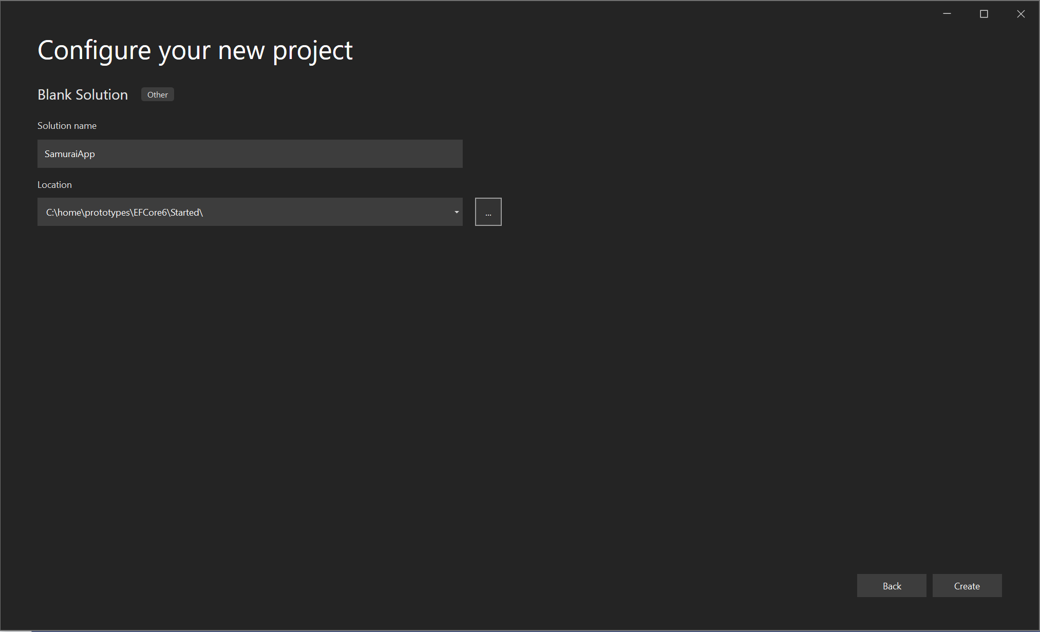
Blank solution

Slide 4
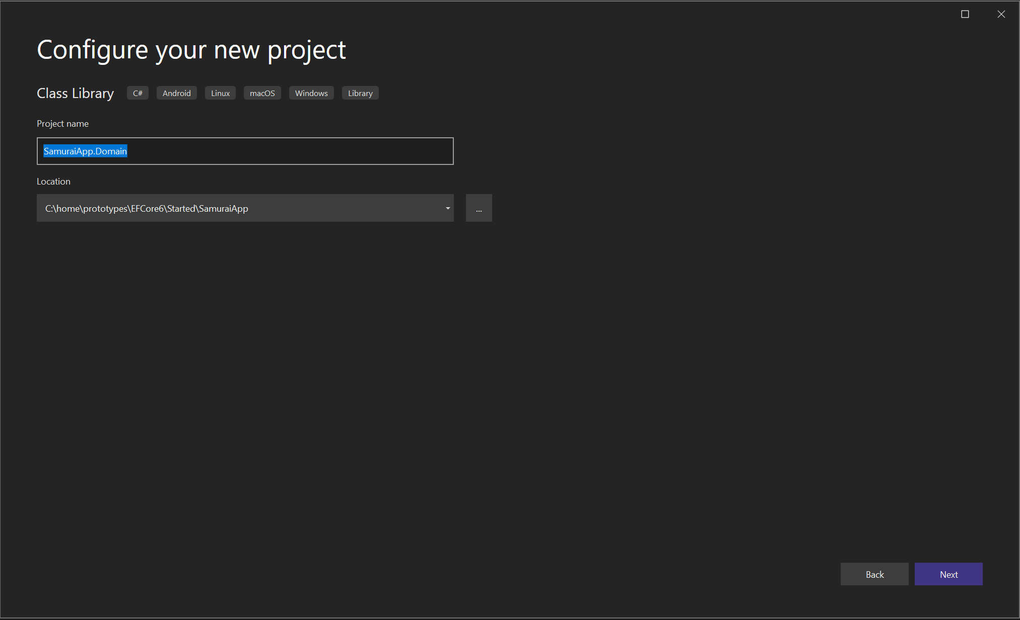
Create domain classes

Slide 5
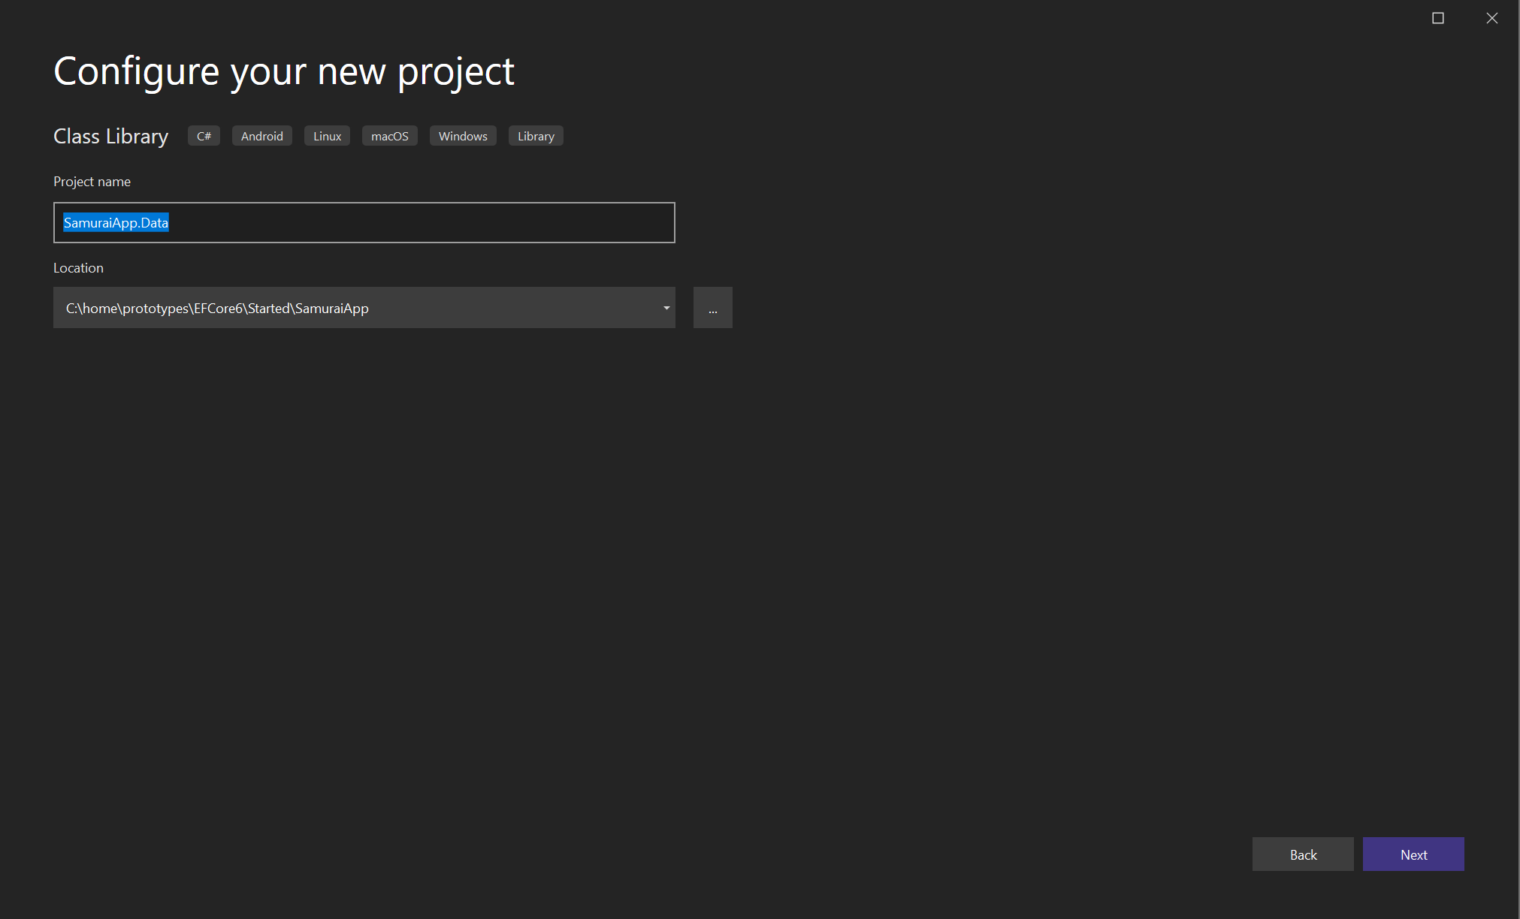
DATA

Slide 6
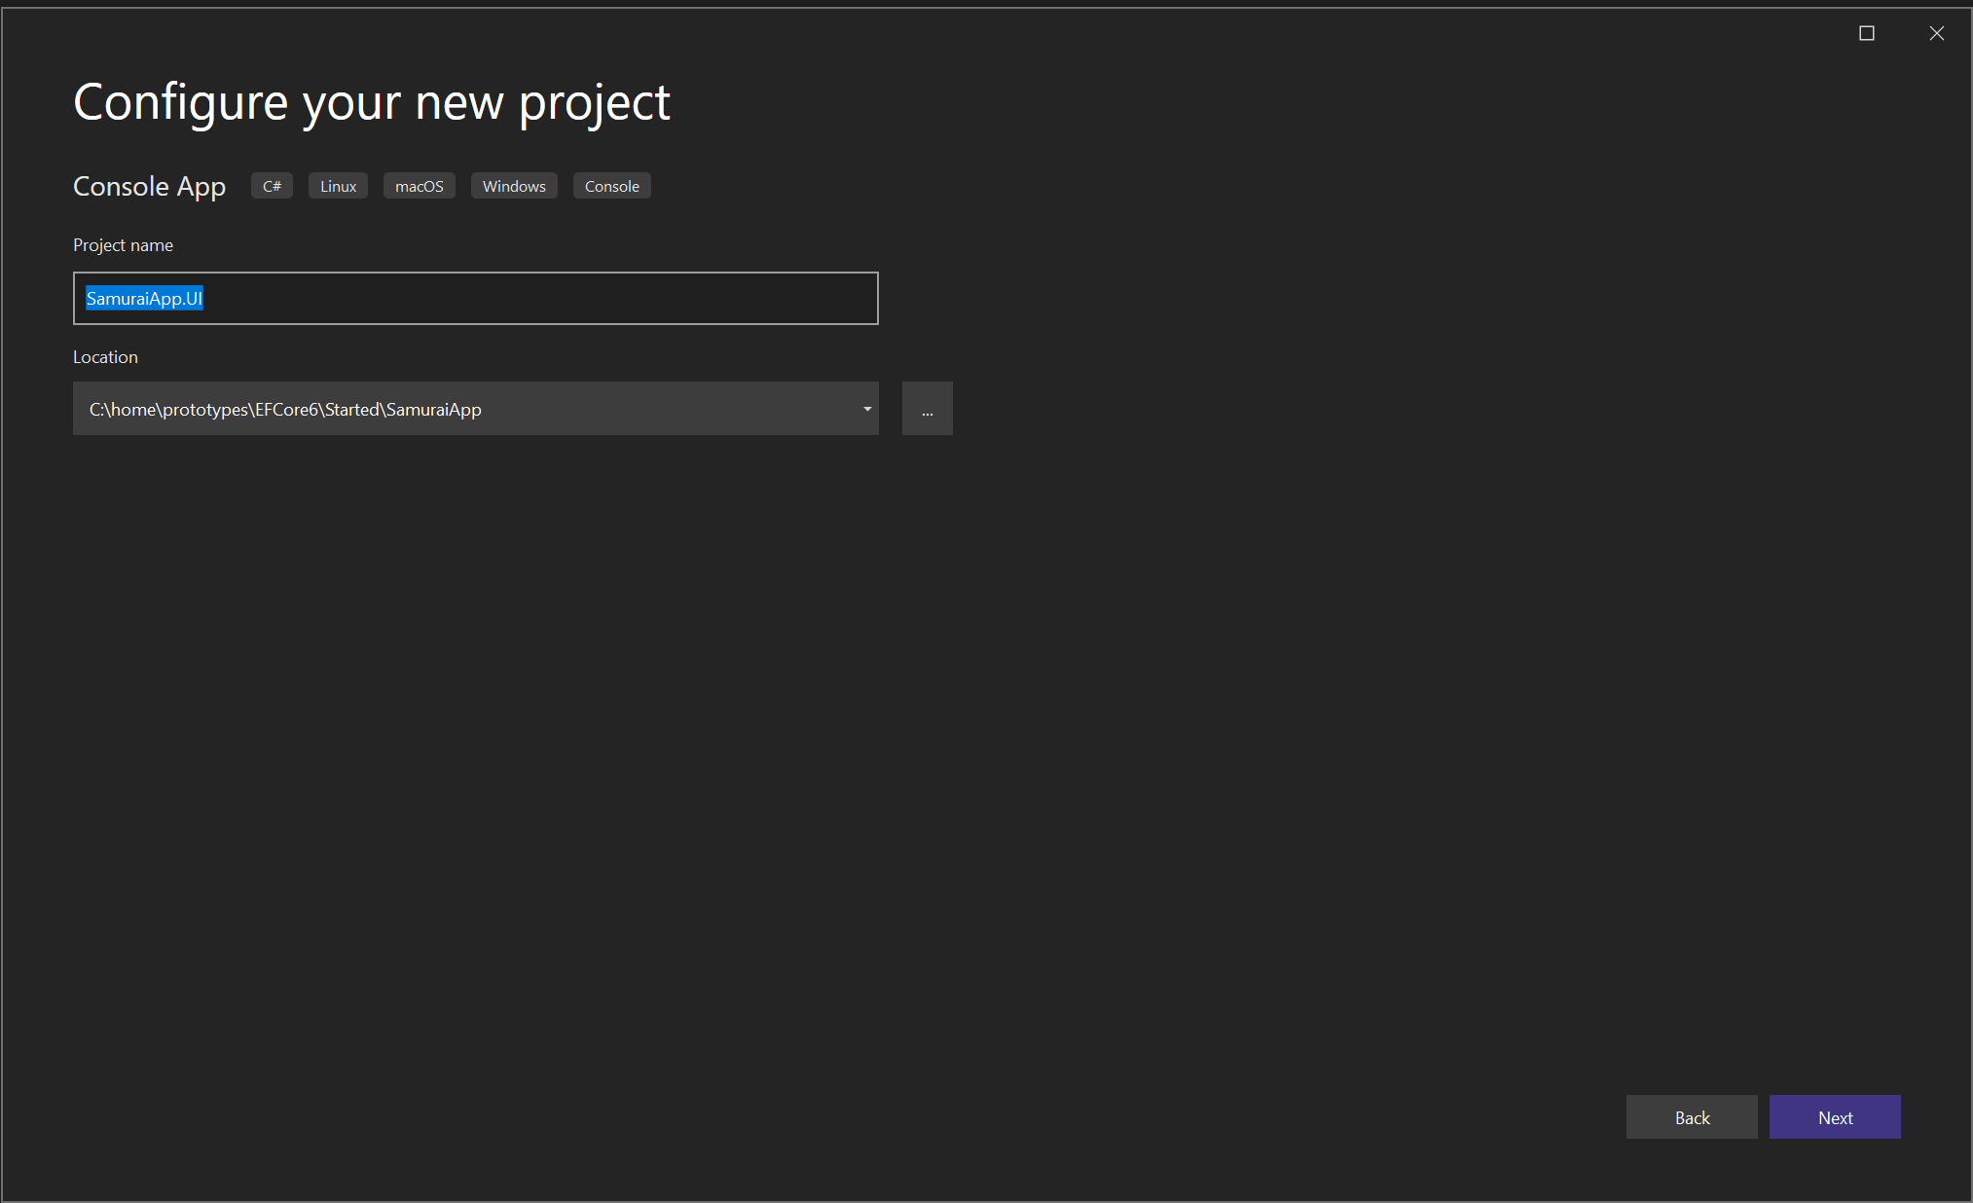
UI

Slide 7
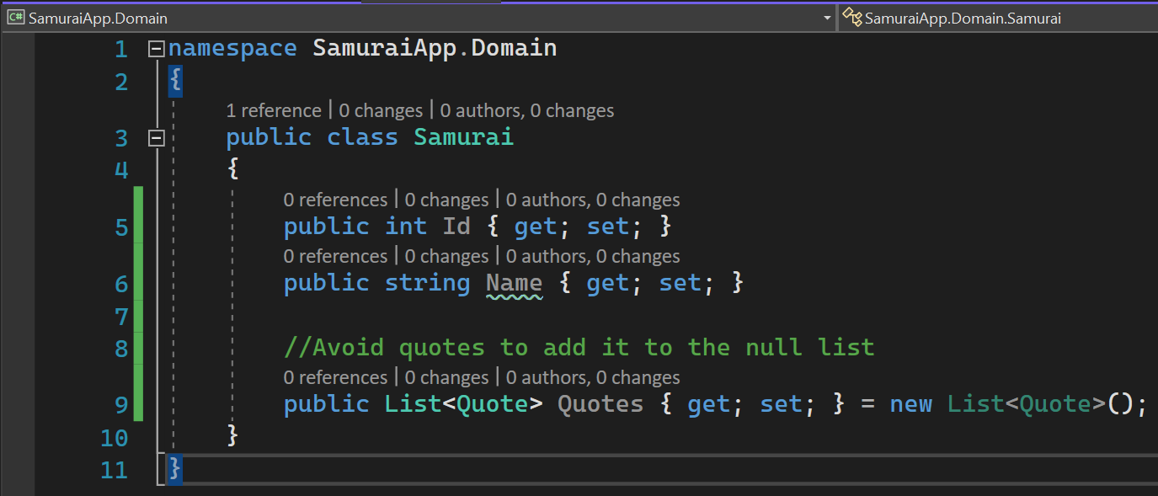
Domain class samurai

Slide 8
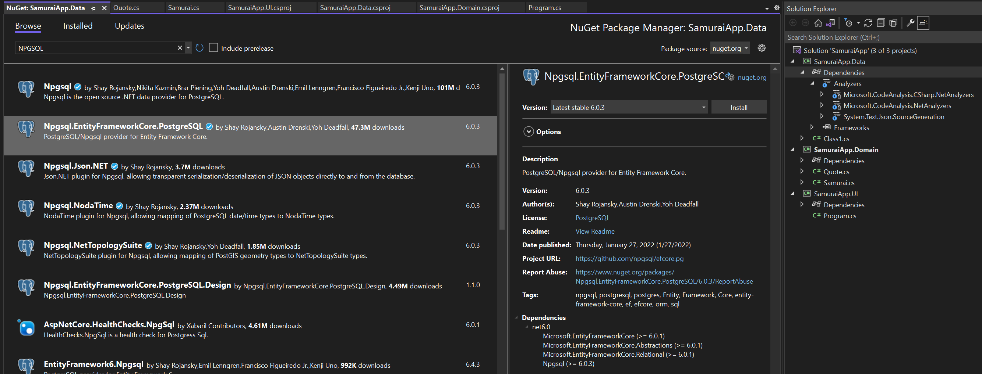
EF CORE

Slide 9
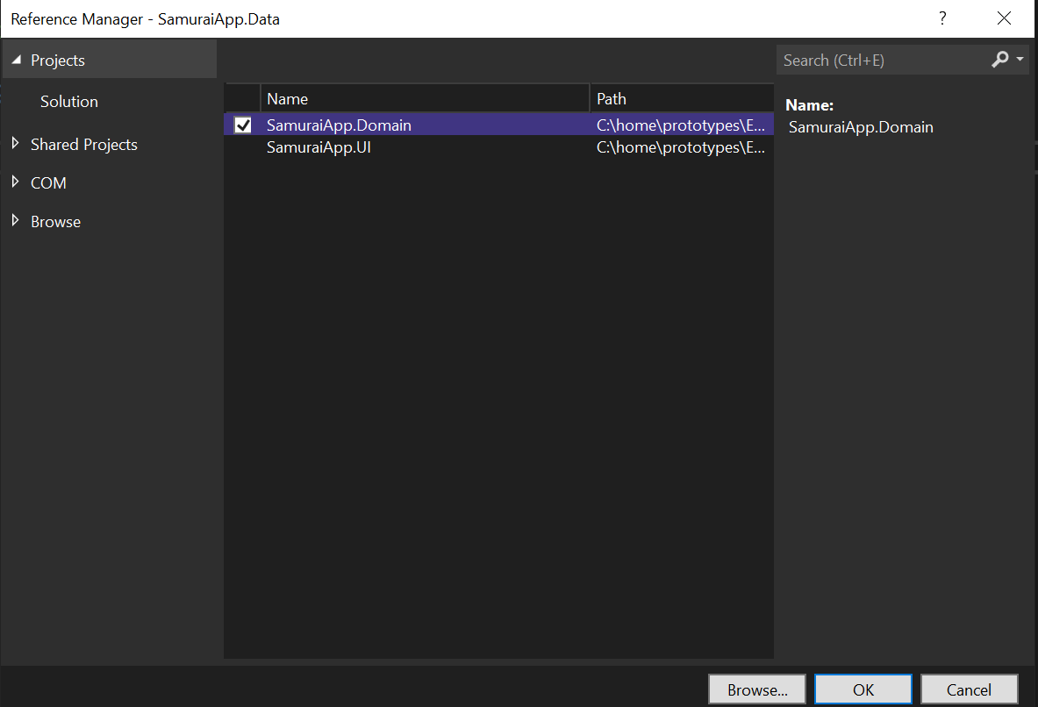
ADD PROJECT REFERENCE

Slide 10
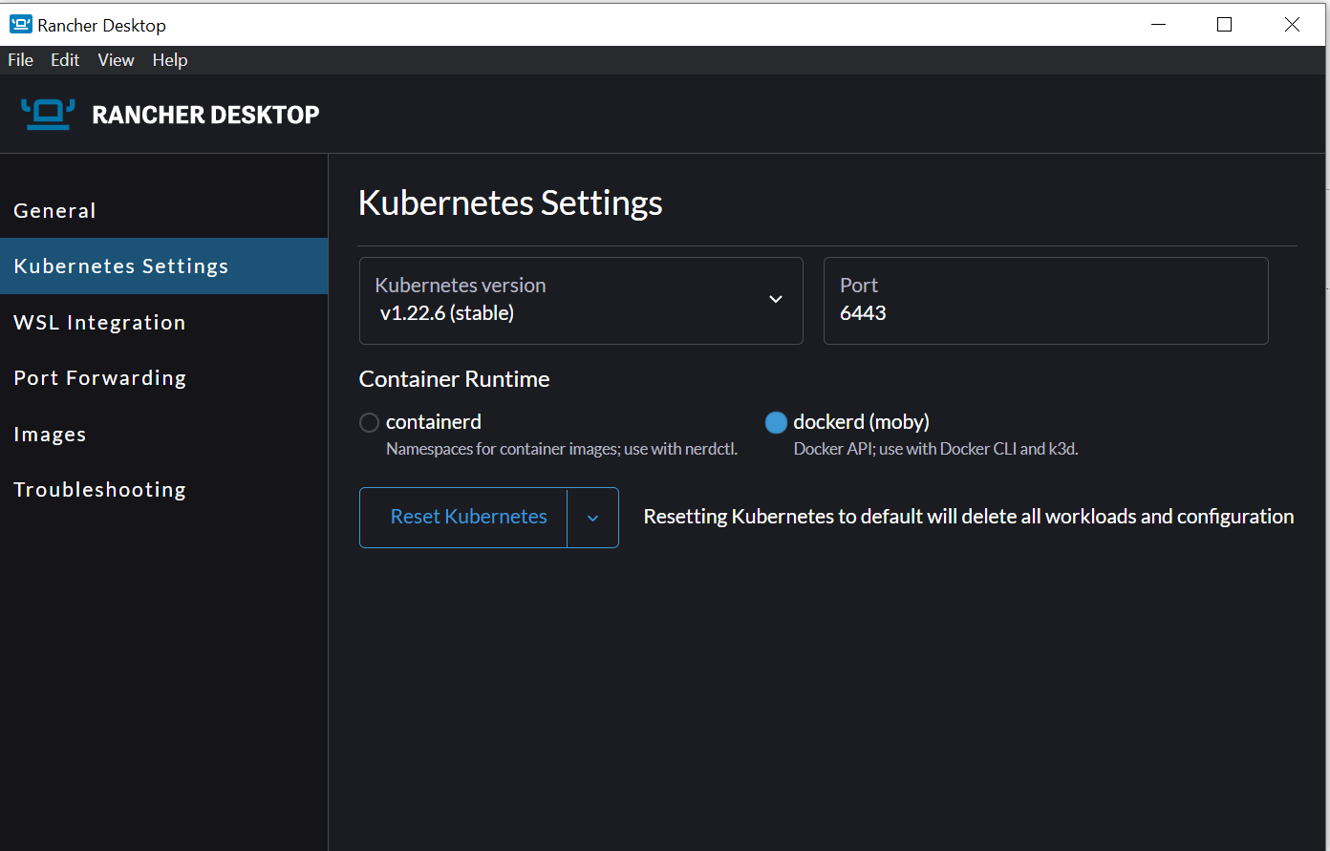
Install rancher
docker run --name postgres_proto -e POSTGRES_PASSWORD=sandeep -p 5435:5432 -d postgres

Slide 11
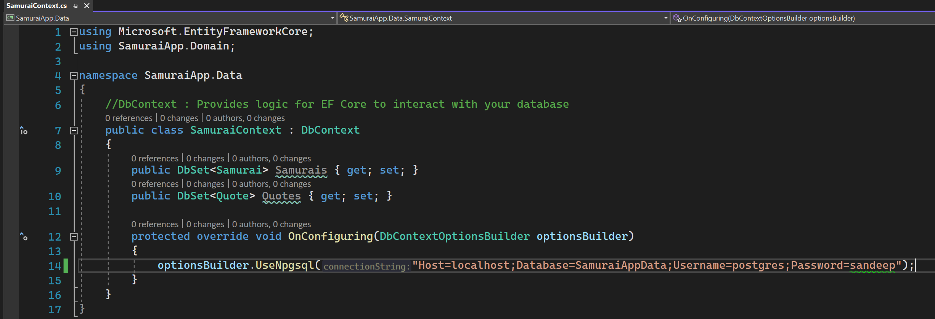
Samurai context

Slide 12
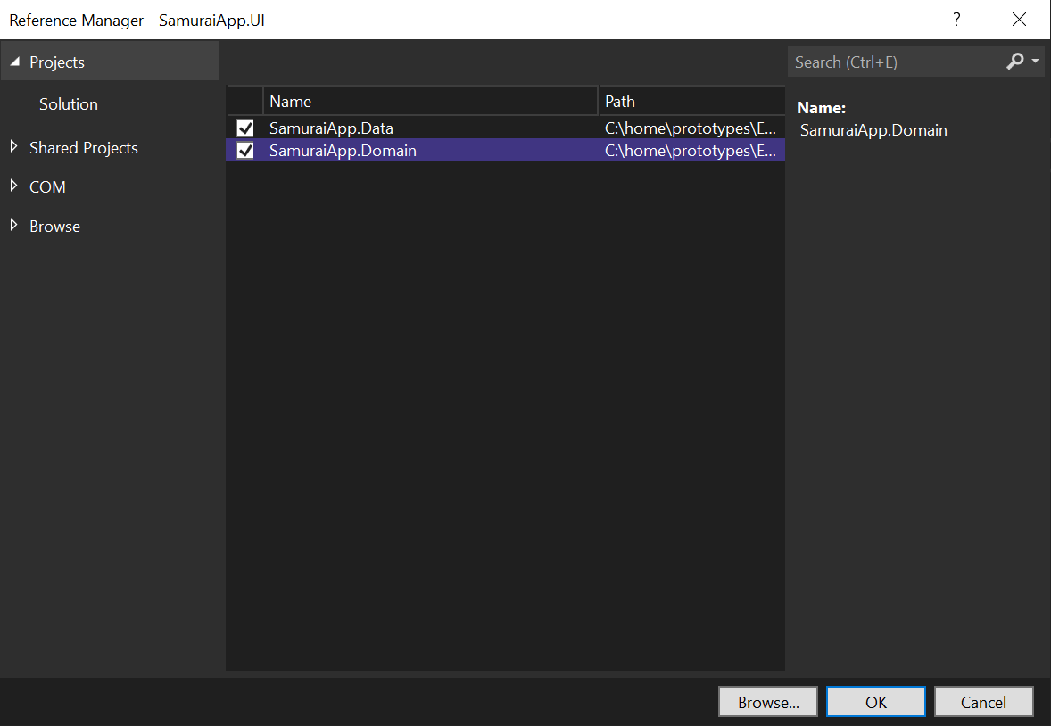
Adding context

Slide 13
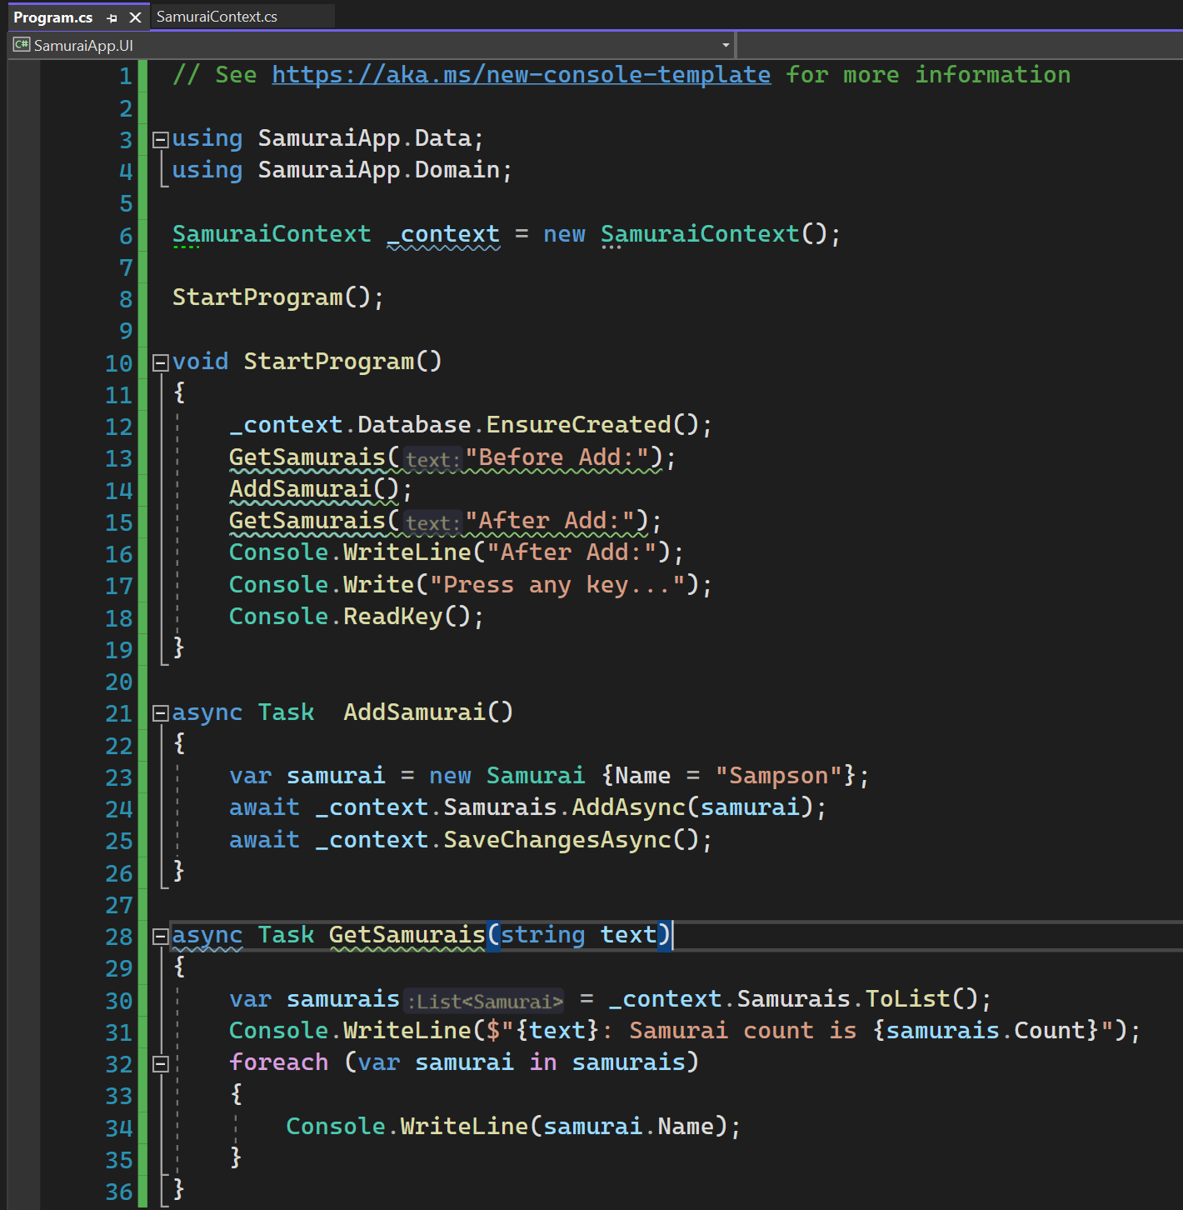
SAMURAI UI

Slide 14
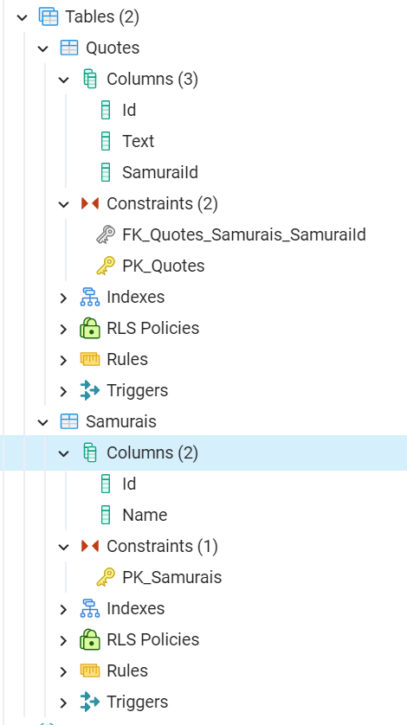
Constraints

Slide 15
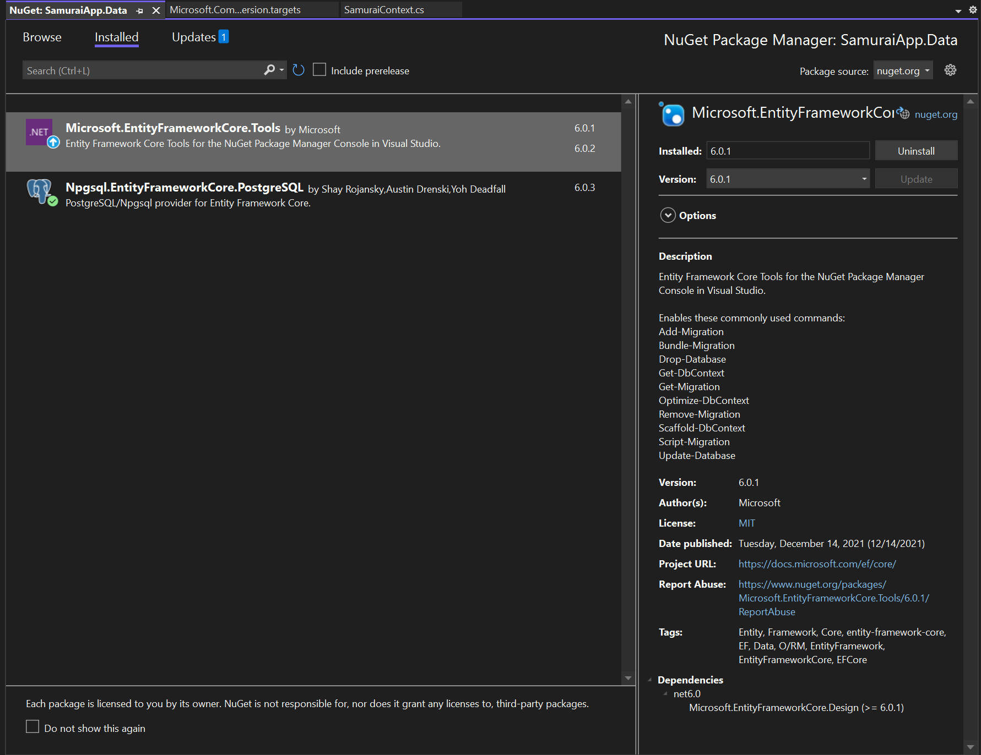
Add Microsoft.entityframework.core.tools

Slide 16
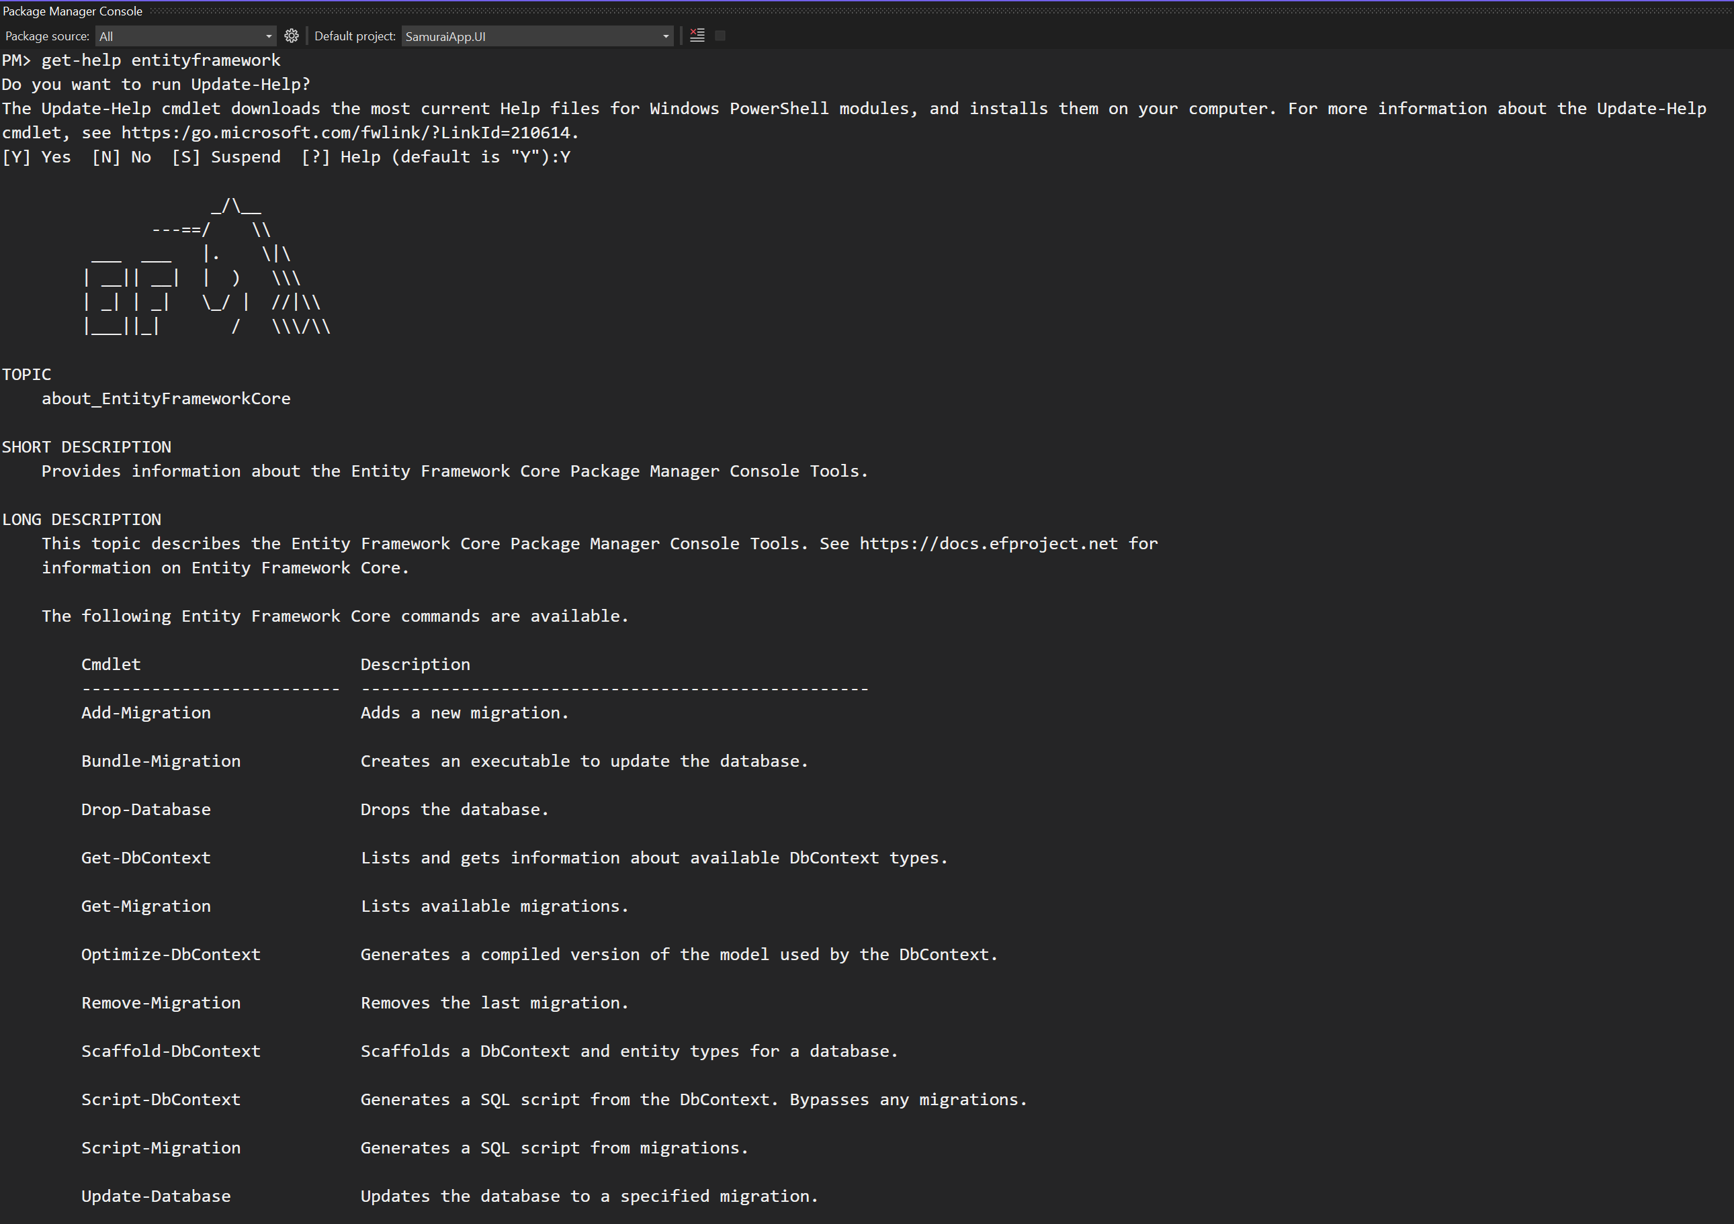
Get-help entity FRAMEWork - 1

Slide 17
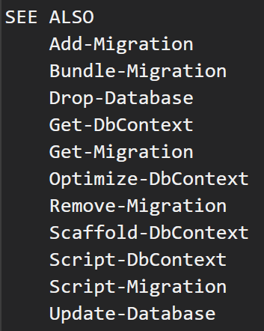
Get-help entity Framework - 2

Slide 18
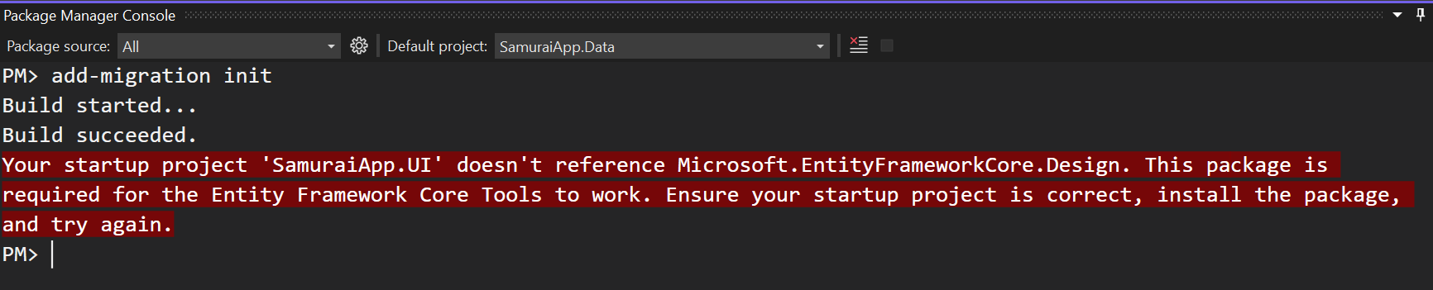
Get-help entity Framework - 3

Slide 19
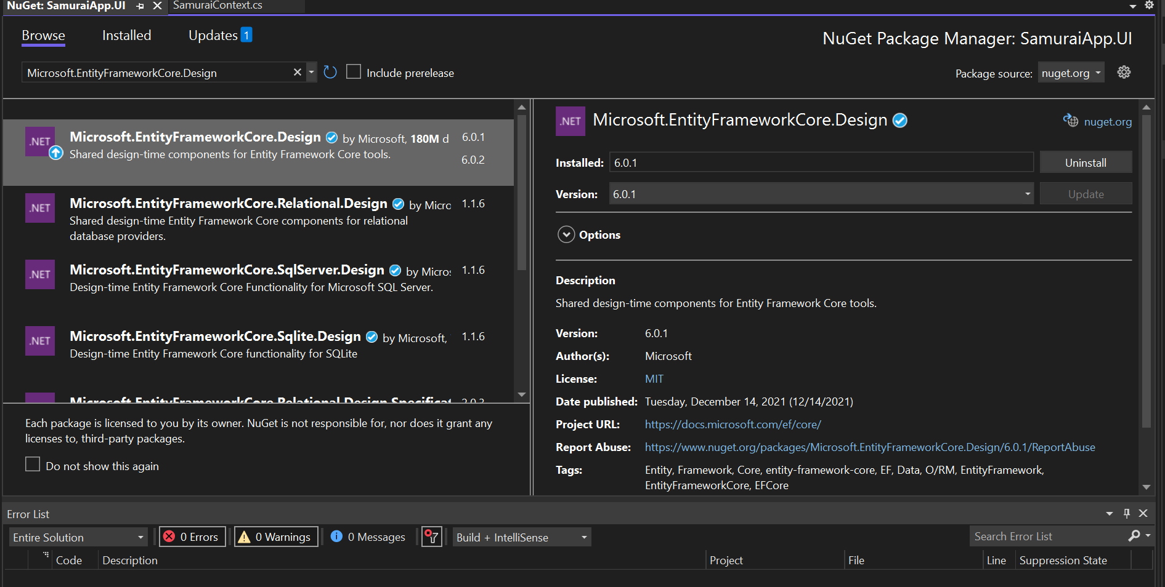
Add in the UI

Slide 20
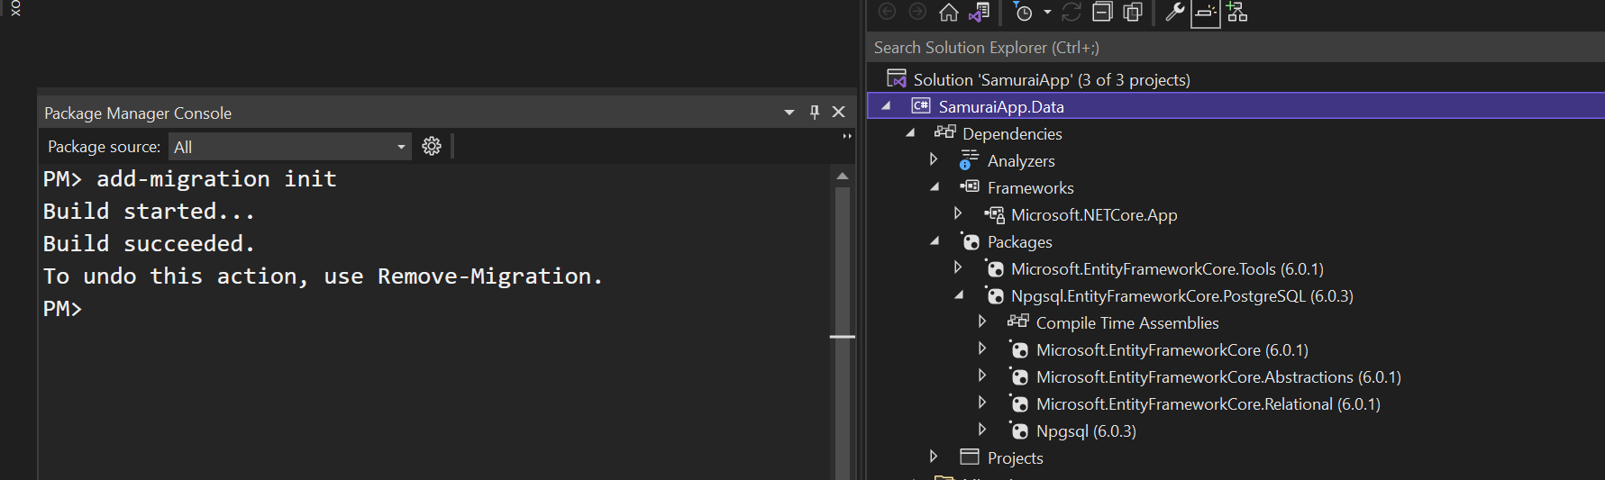
Add migration

Slide 21
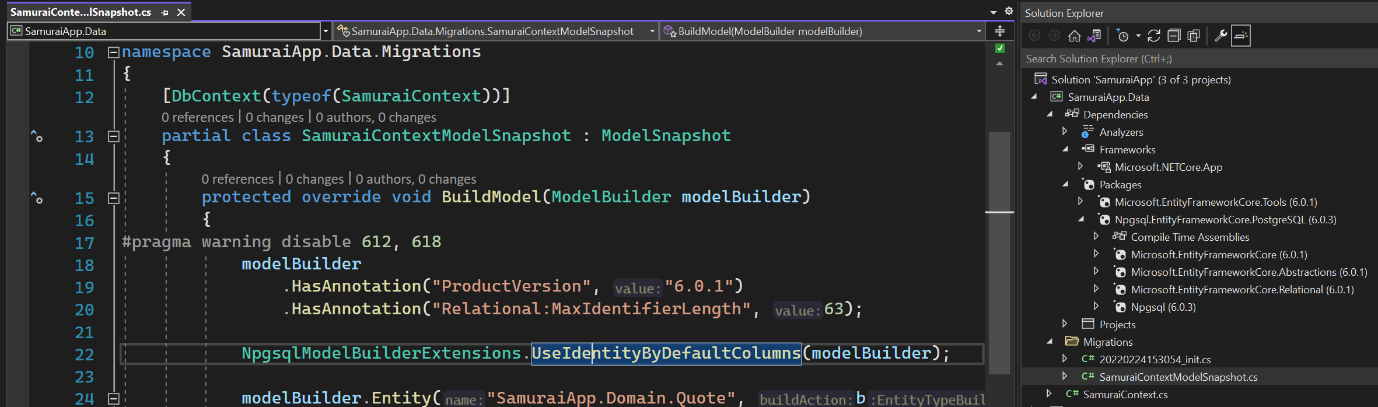
Snapshot
The snapshot is used to determine how to migrate from one model version to next.

Slide 22
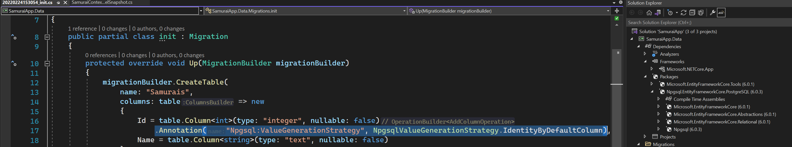
Migration code - Identity column

Slide 23
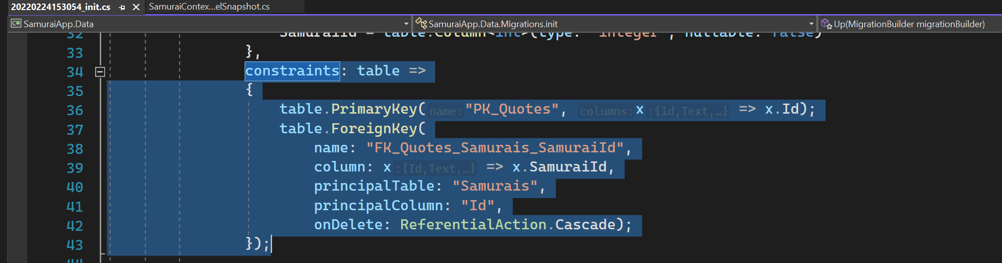
Migration code - constraints
EF Core recognized one to many relationship

Slide 24
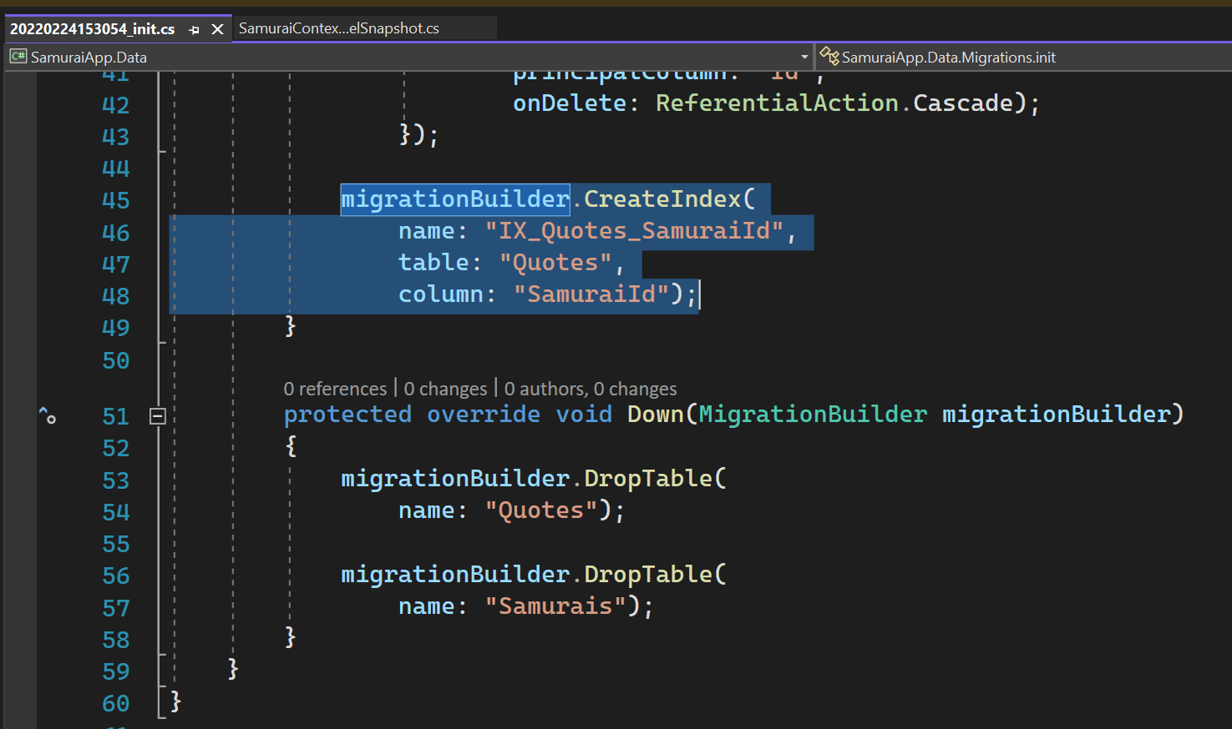
Migration code - index
Create index for foreign key that discovers on the model.

Slide 25
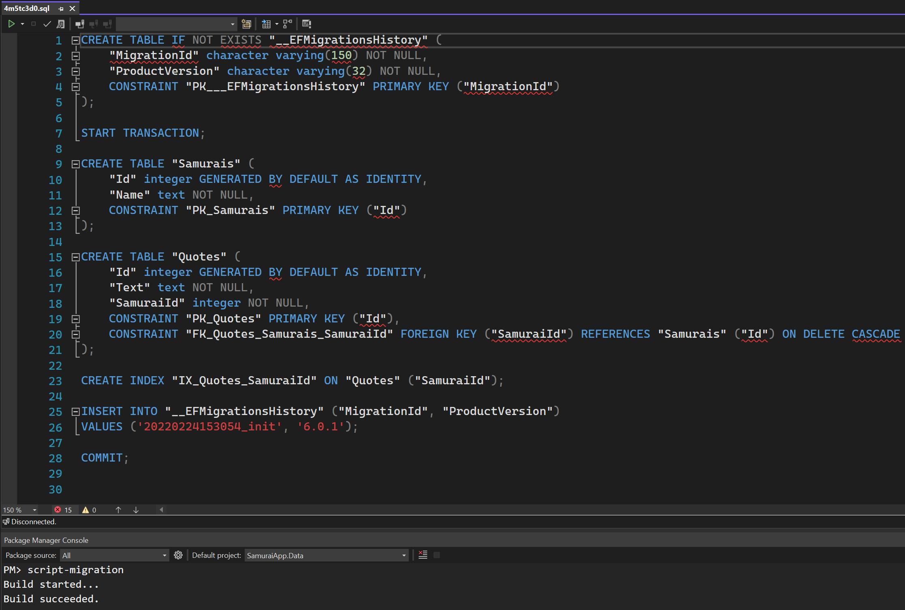
Script migration

Slide 26
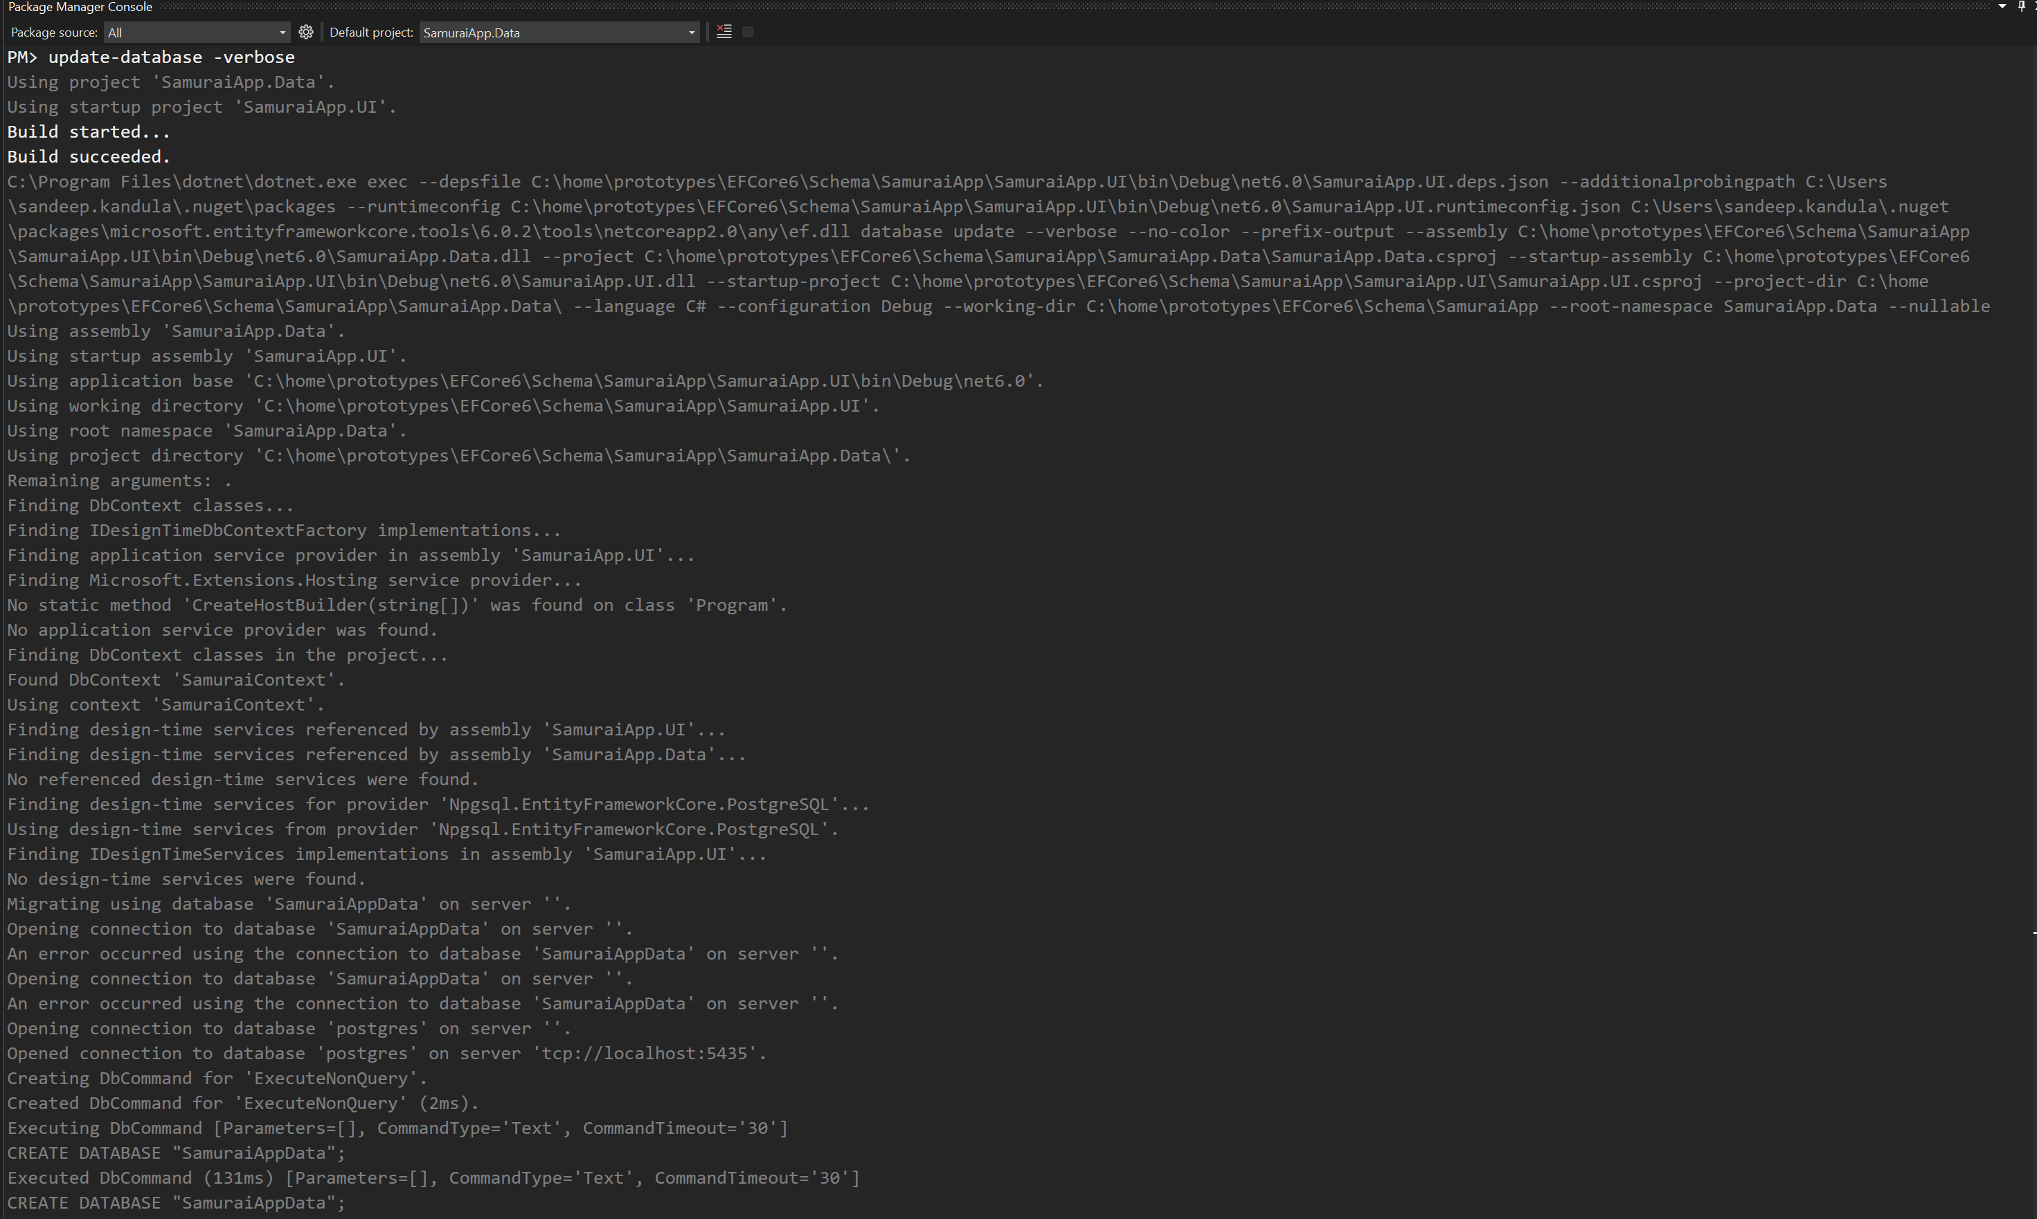
Update-database

Slide 27
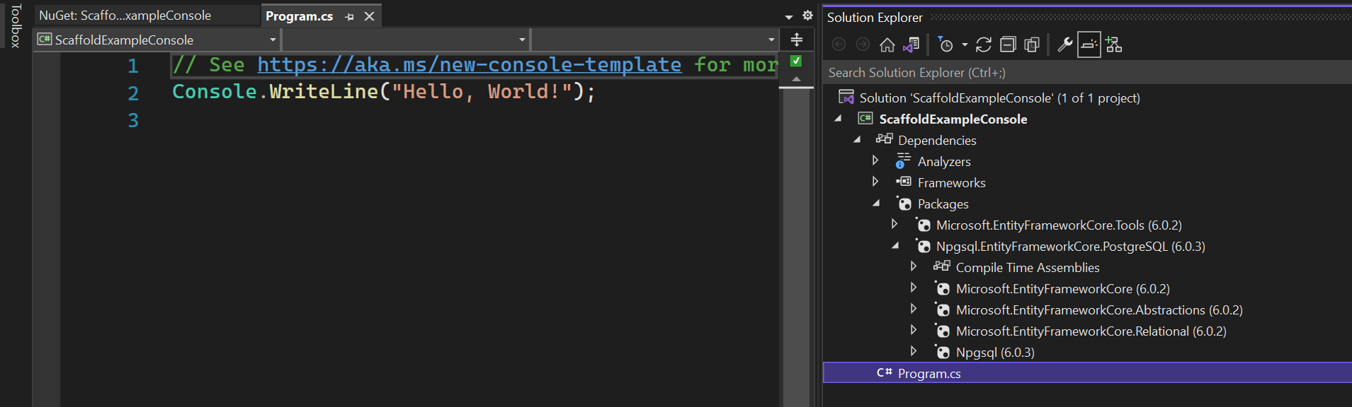
ReverSe engineer an existing database - 1
https://cmatskas.com/ef-core-migrations-with-existing-database-schema-and-data/

Slide 28
ReverSe engineer an existing database - 2
https://cmatskas.com/ef-core-migrations-with-existing-database-schema-and-data/

Slide 29
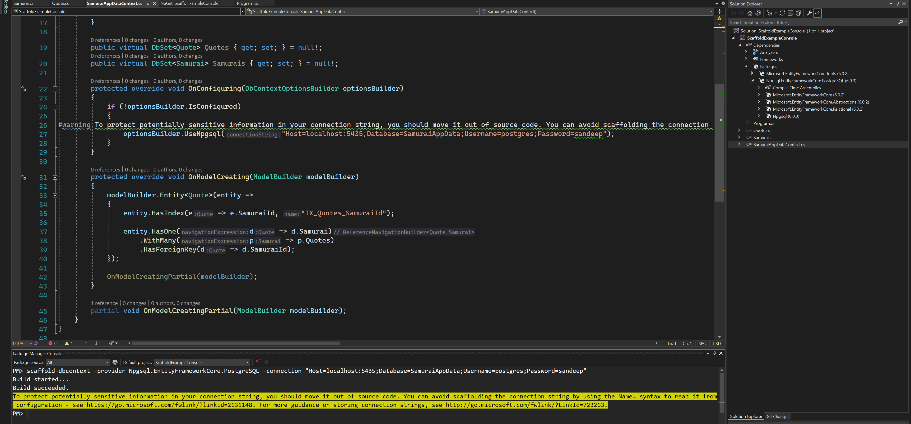
ReverSe engineer an existing database - 3

Slide 30
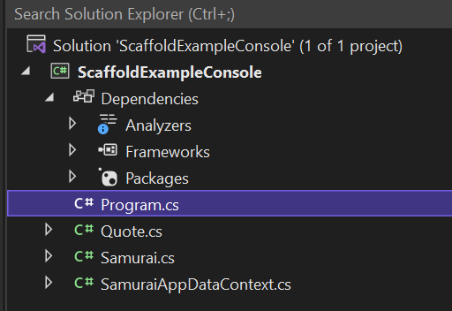
EF Core 6
EF Core 6 scaffolding now defaults to creating singular names for the entity classes.

Slide 31
Defining relationships in model

Slide 32
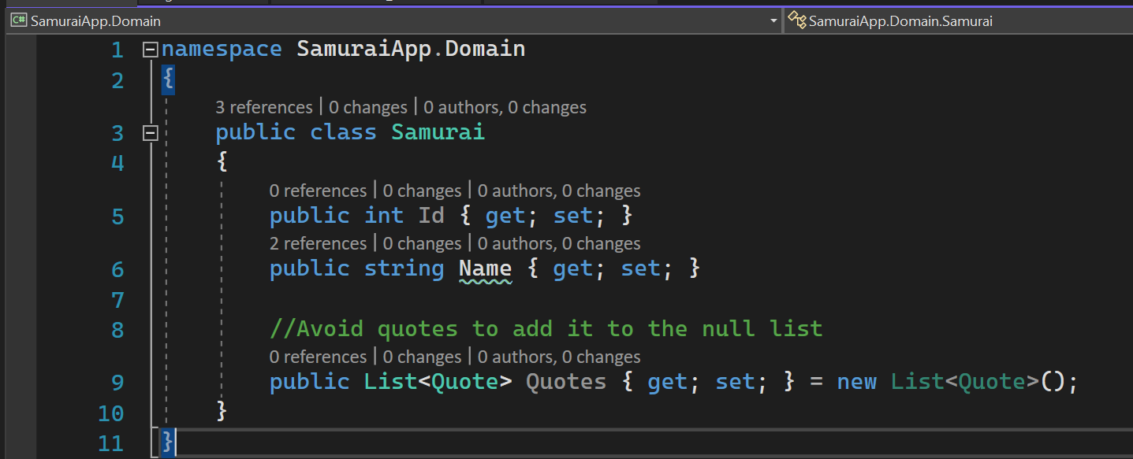
One to Many relationship
EF Core will also recognize Collection<T> and Enumerable<T>

Slide 33
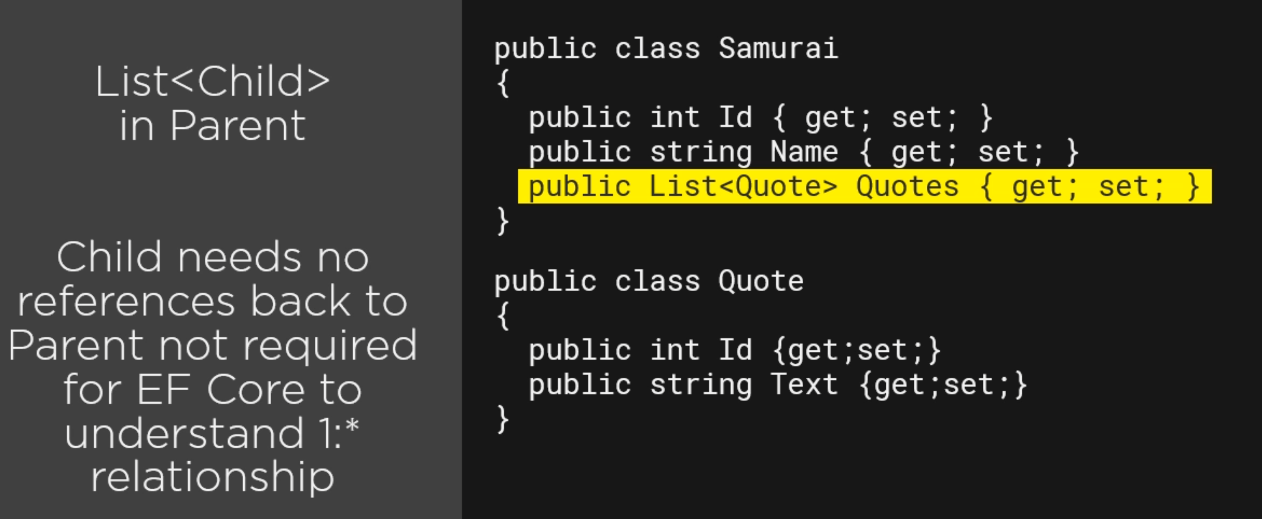
1: * :Relation Type 1

Slide 34
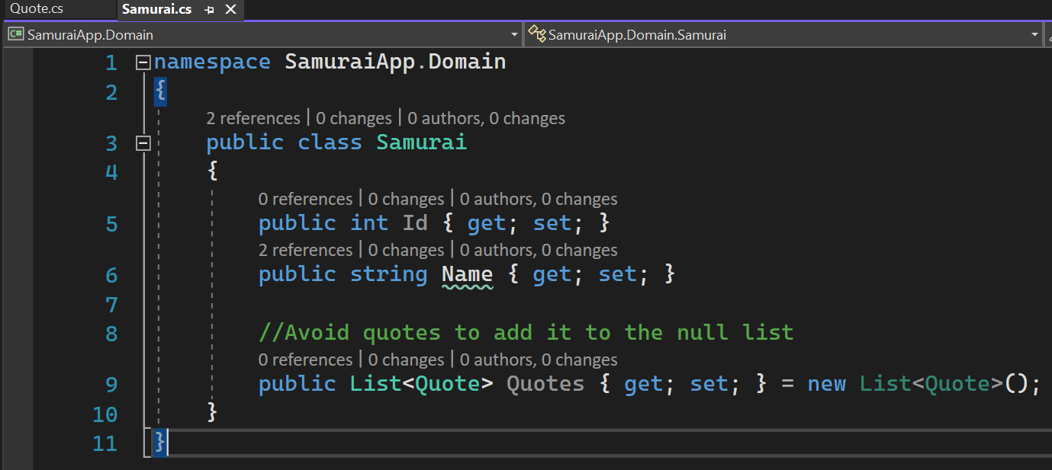
1: * Relation Type 1 - 1

Slide 35
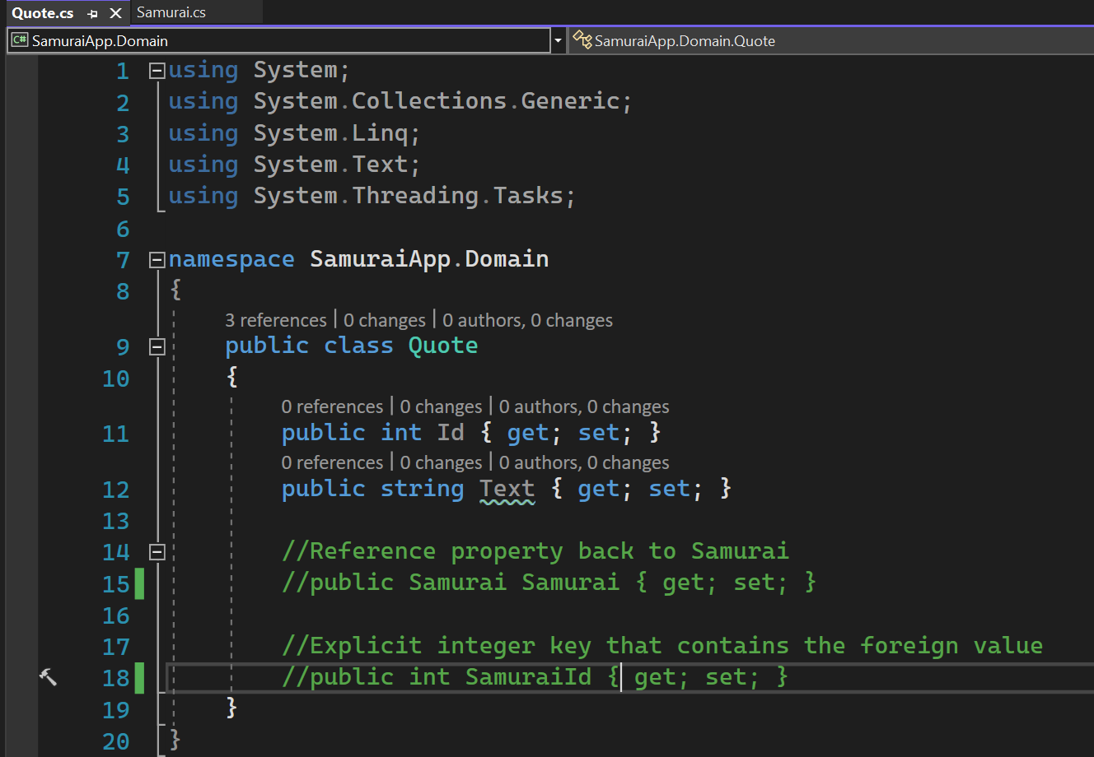
1: * Relation Type 1 - 2

Slide 36
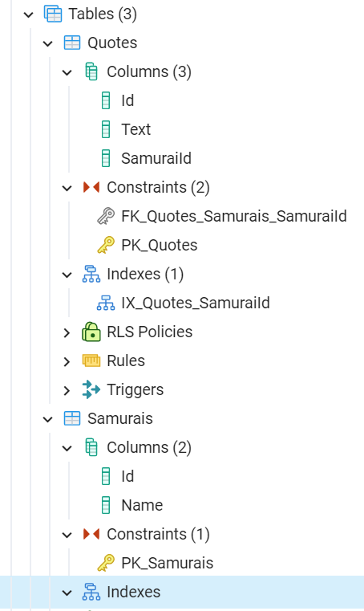
1: * CONSTRAINTS

Slide 37
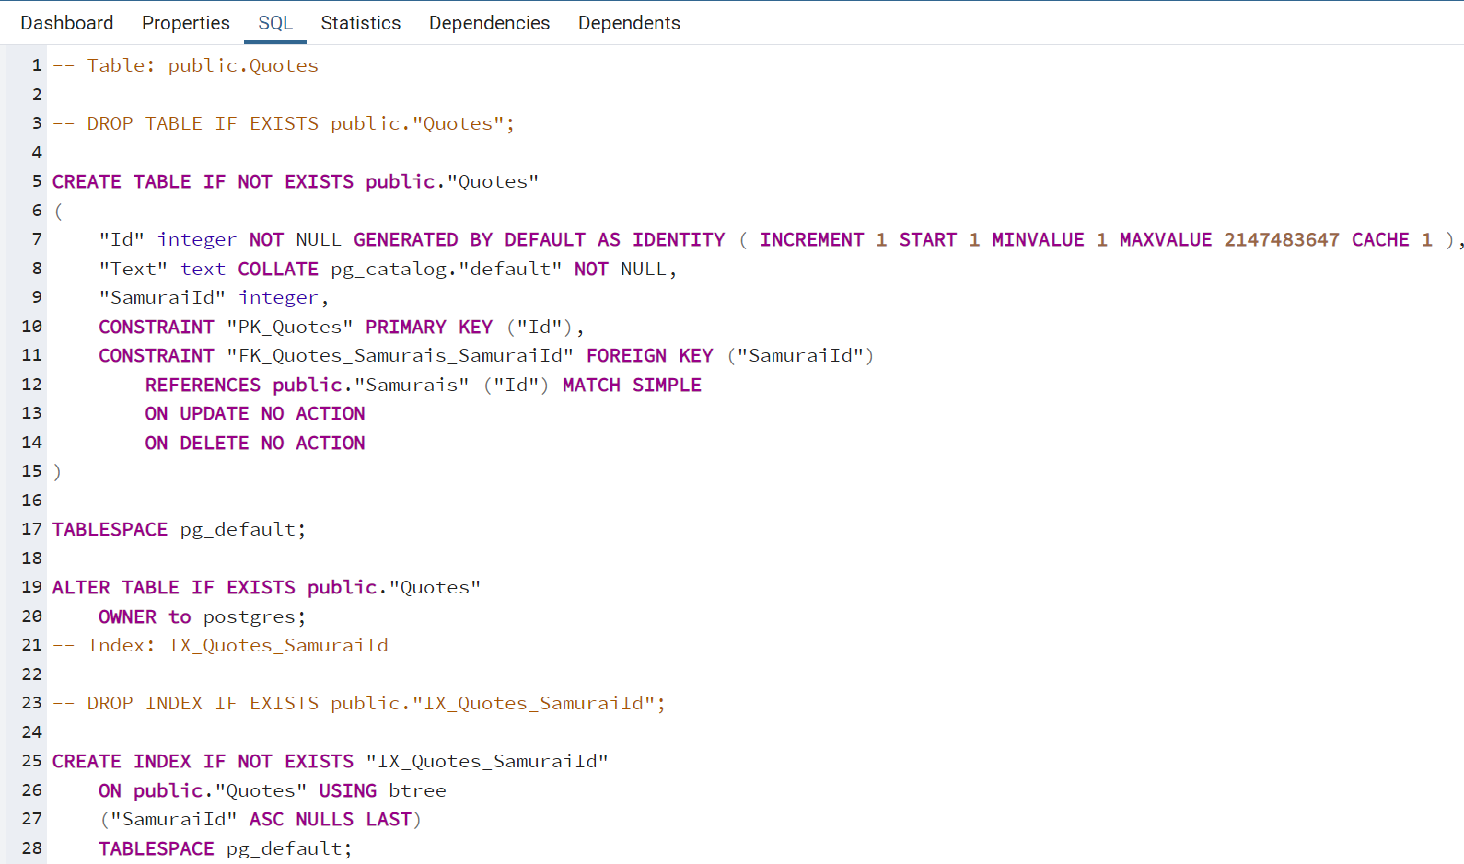
1: * CONSTRAINTS

Slide 38
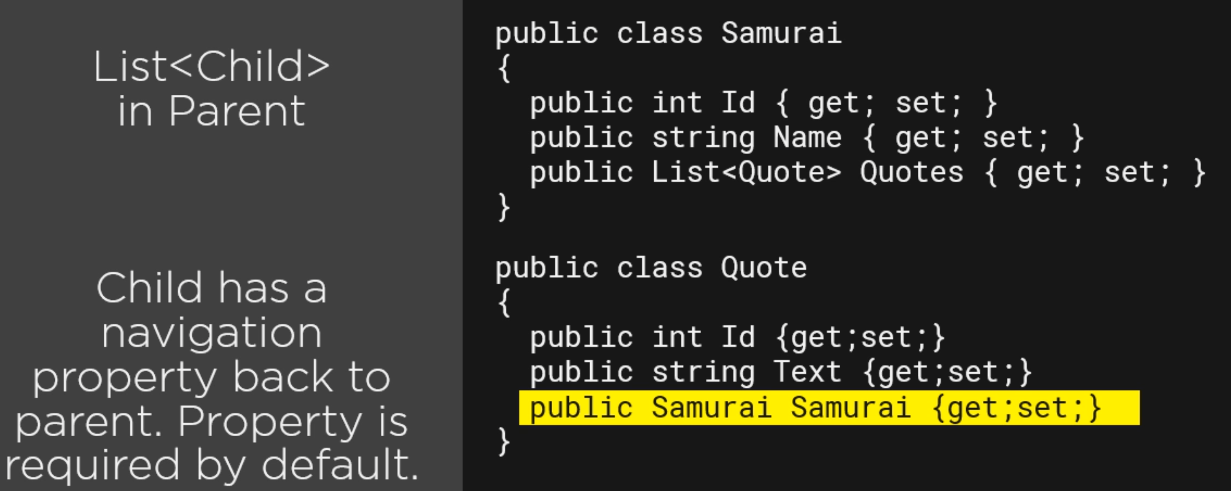
1: * Relation type 2
Samurai can be null and therefore a quote can exist without Samurai.

Slide 39
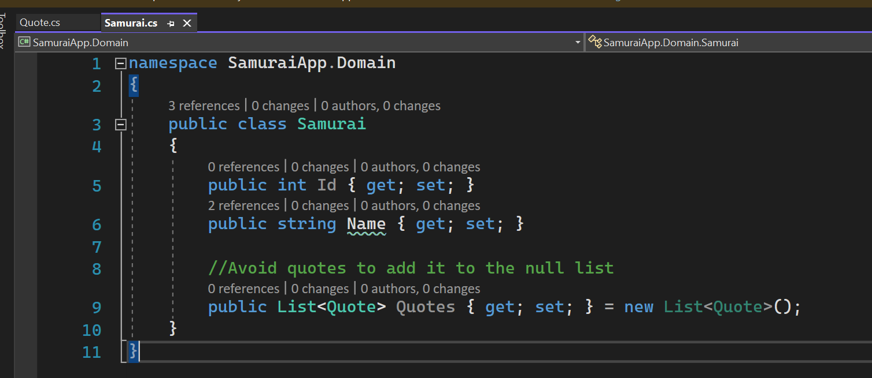
1: * Relation type 2 - 1

Slide 40
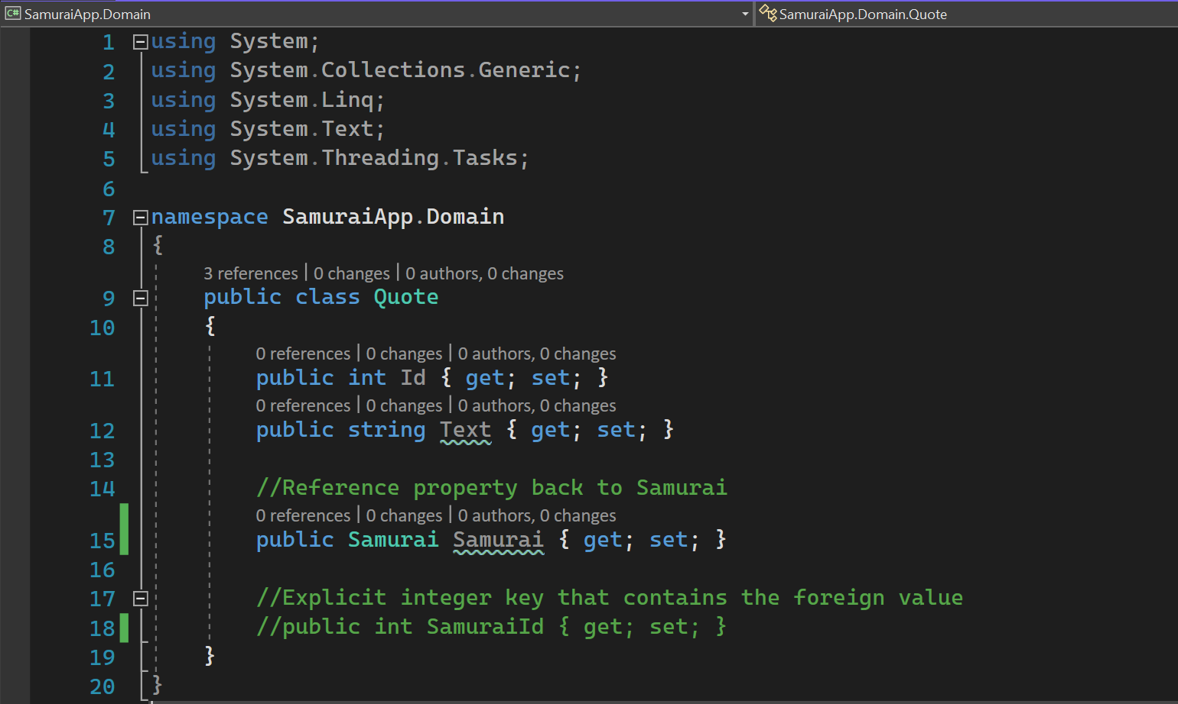
1: * Relation type 2 - 2

Slide 41
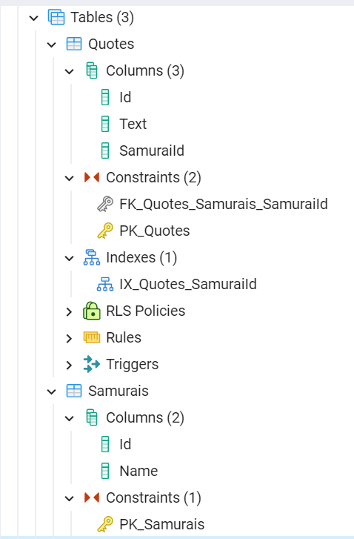
1: * Constraints 1

Slide 42
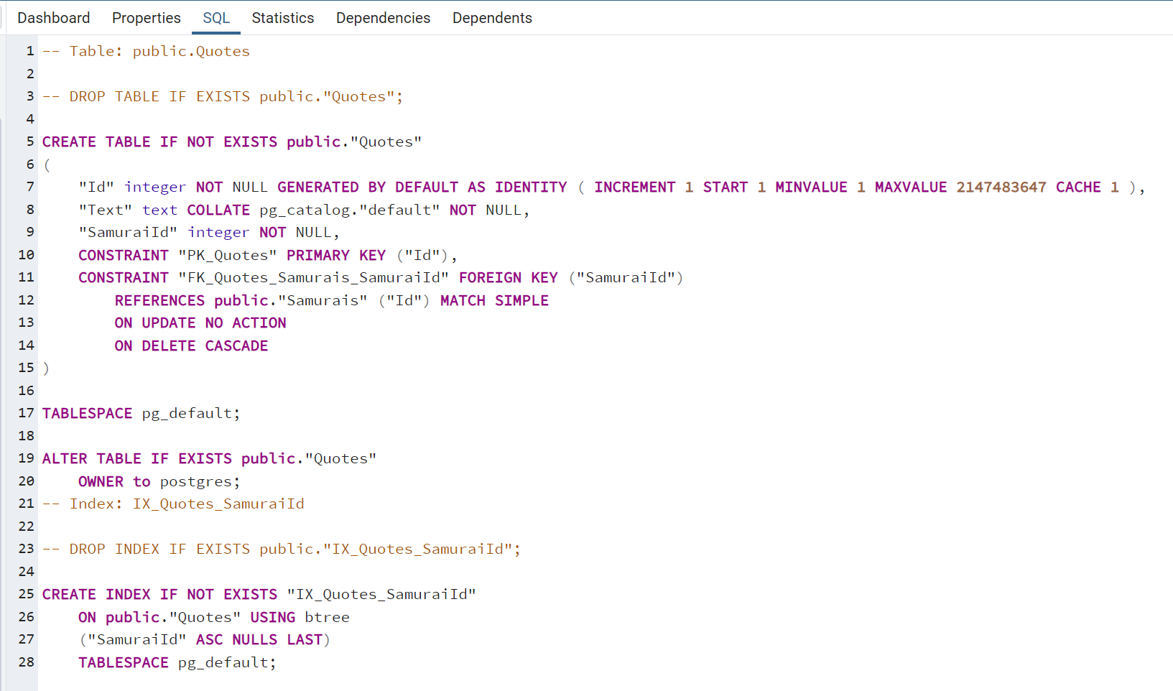
1: * Constraints 2

Slide 43
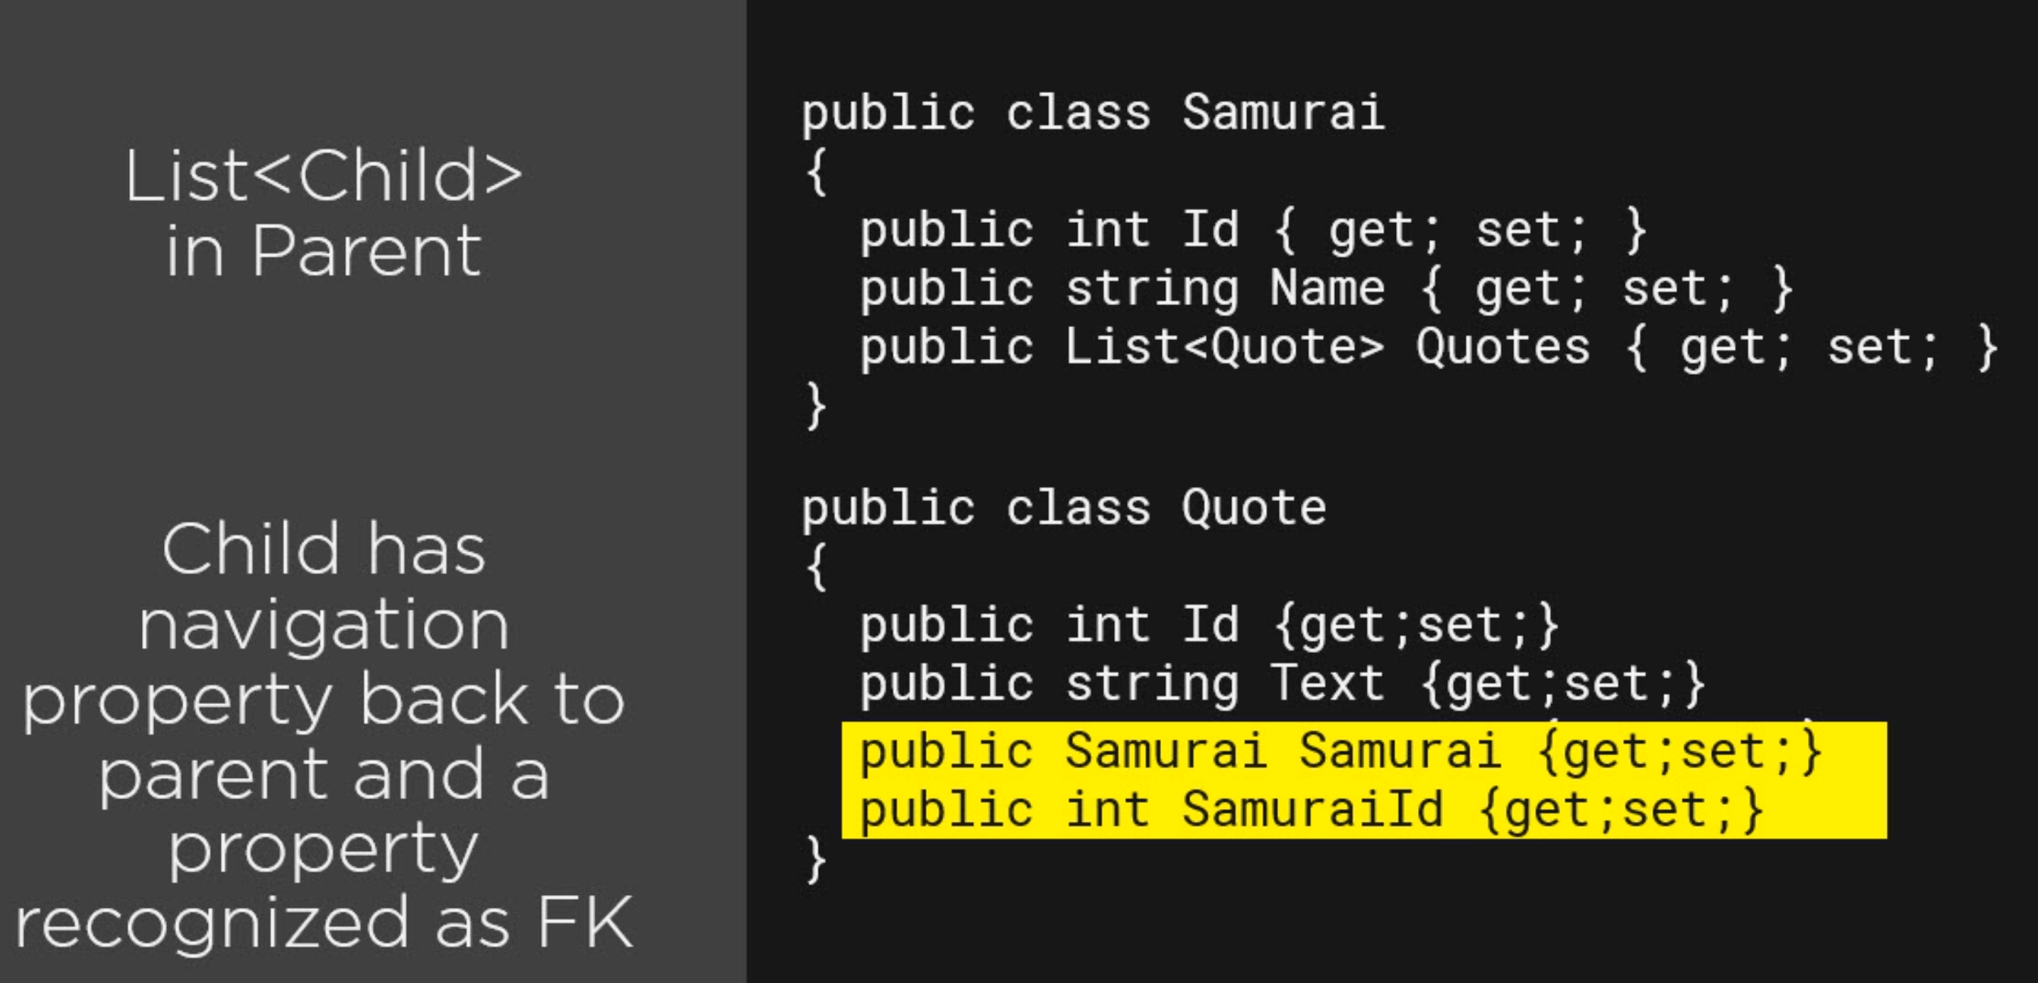
1: * Relation type 3

Slide 44
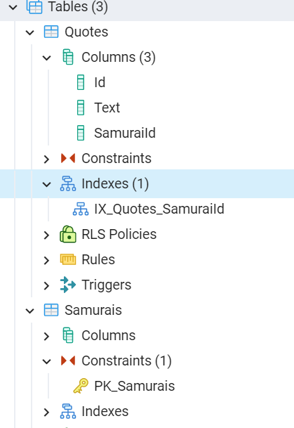
1: * CONSTRIANTS -1

Slide 45
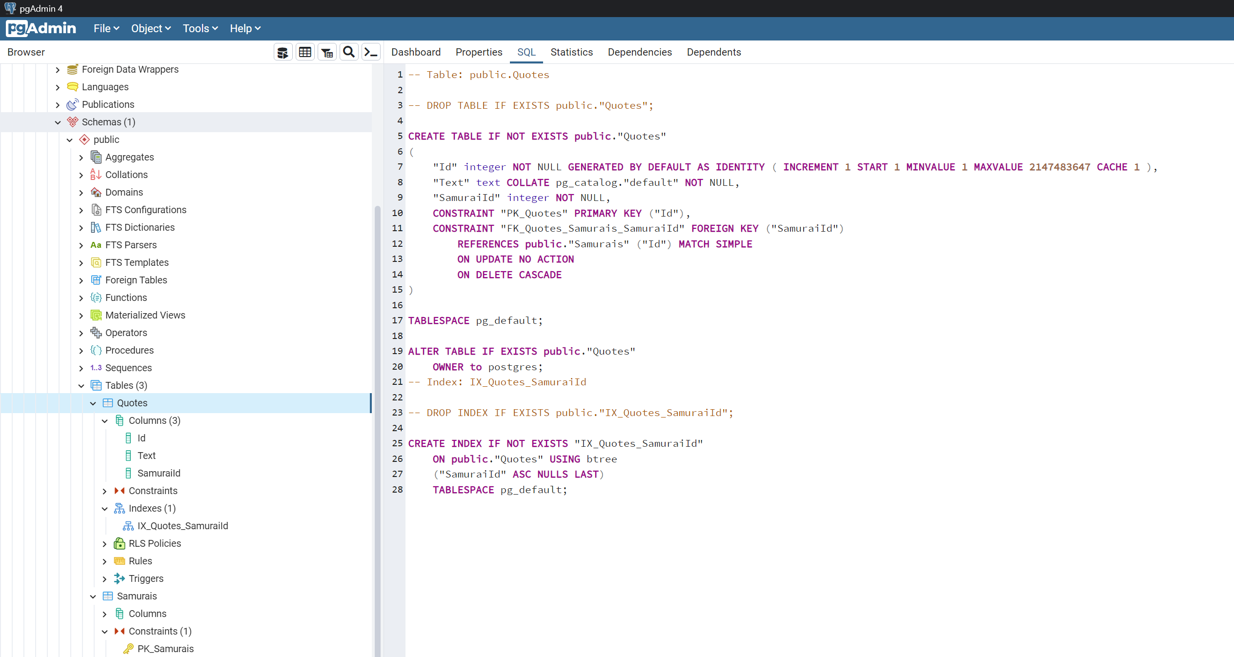
1: * CONSTRIANTS -2

Slide 46
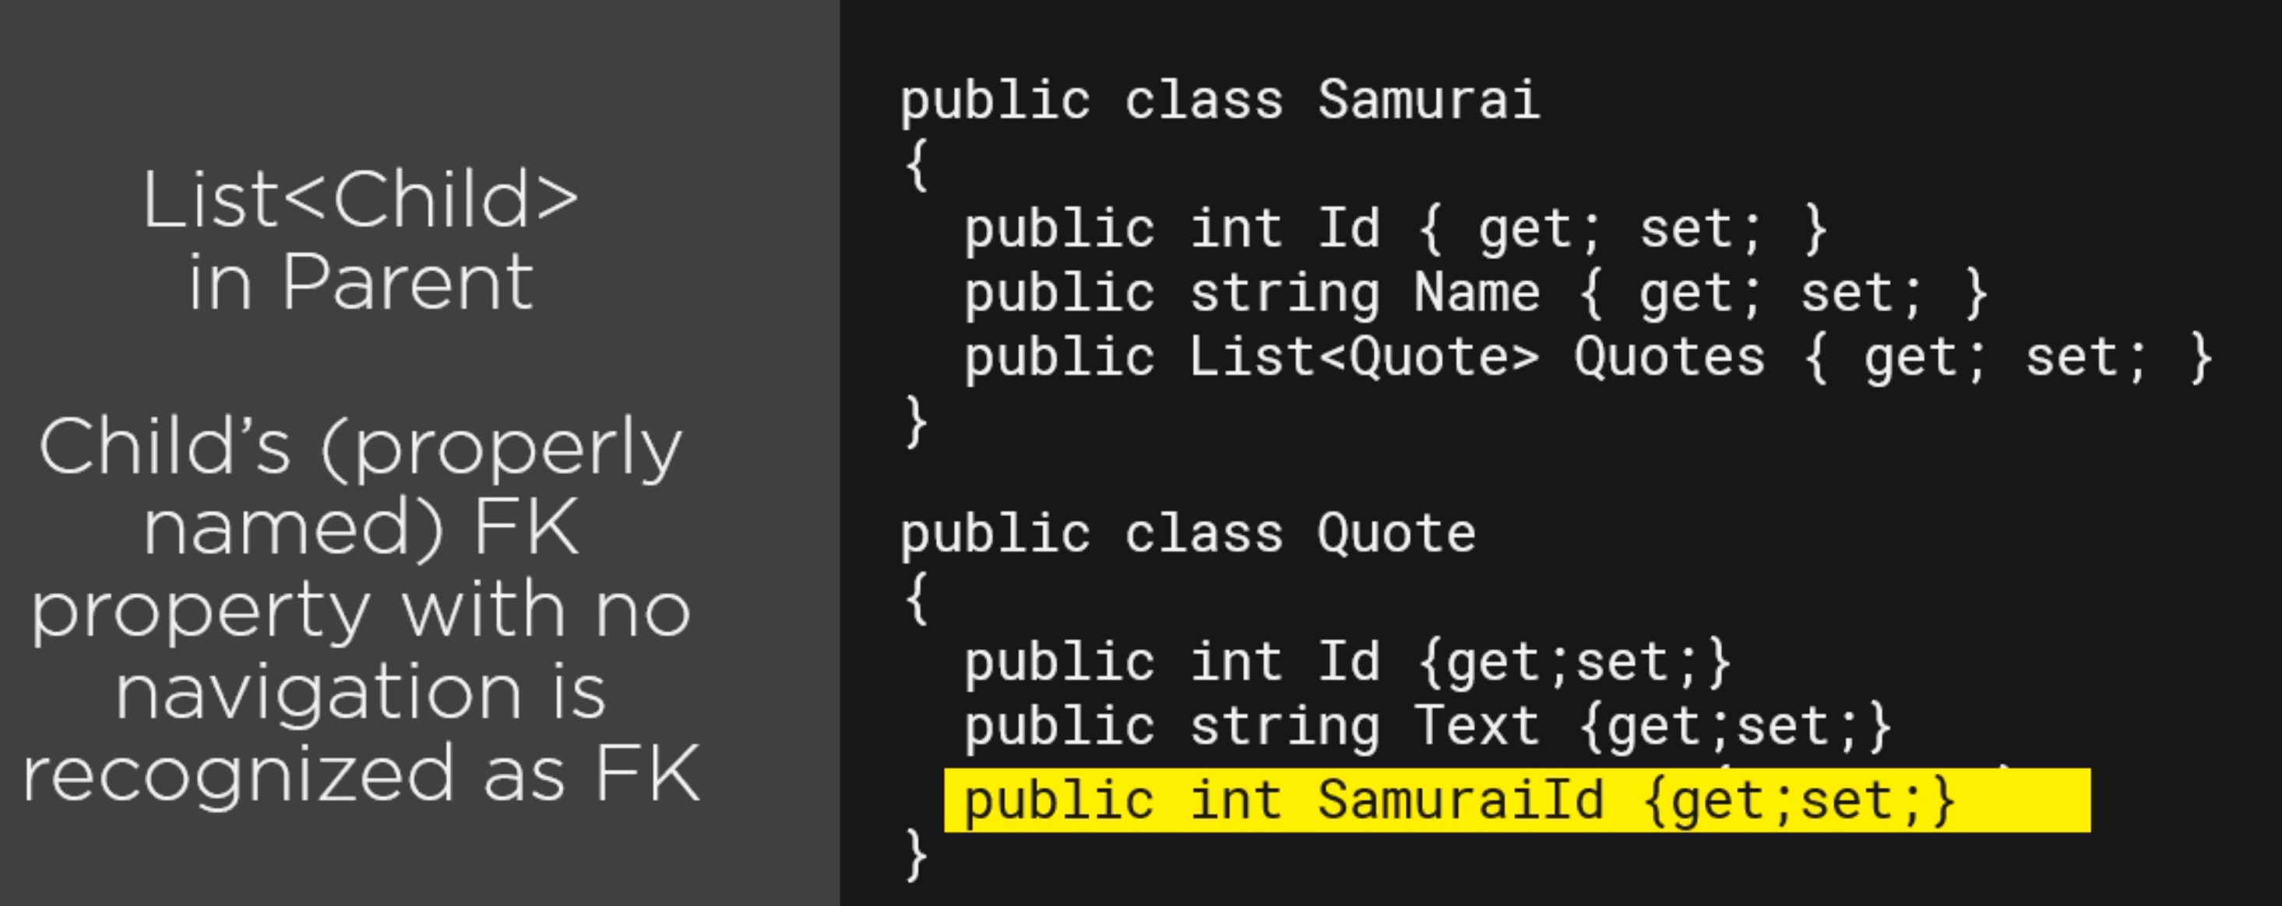
1: * Relation TYPE 4
int is not nullable by default. Therefore a quote can’t exist without Samurai.

Slide 47
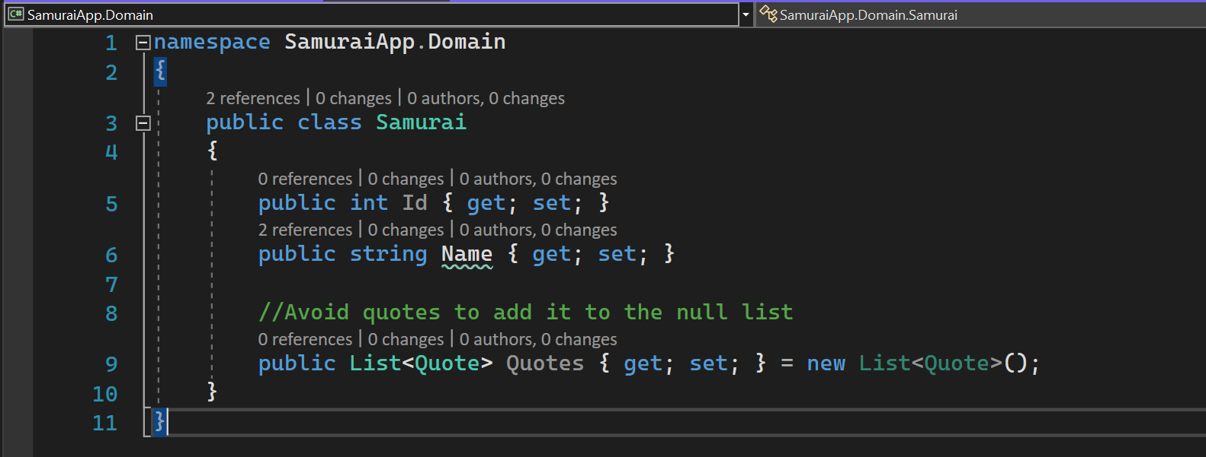
1: * Relation TYPE 4-1

Slide 48
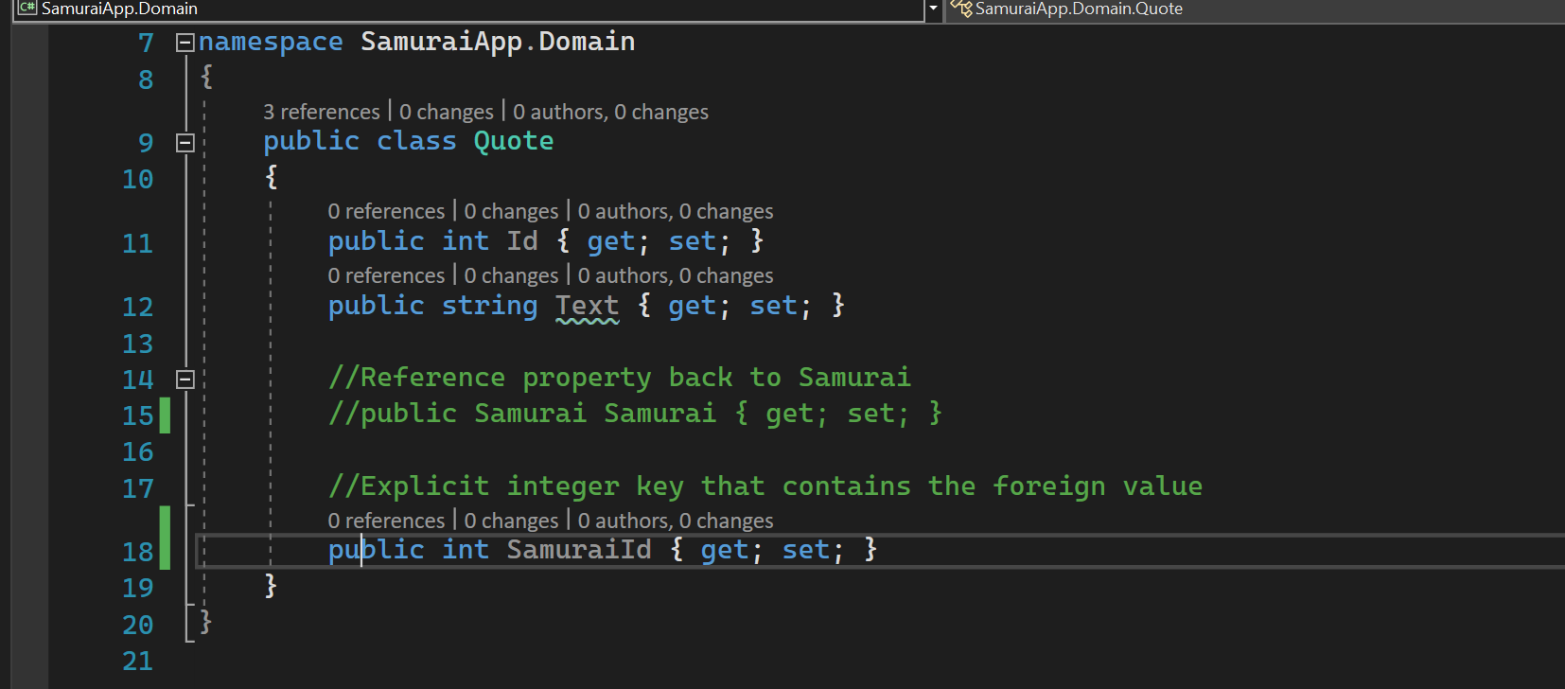
1: * Relation TYPE 4-2

Slide 49
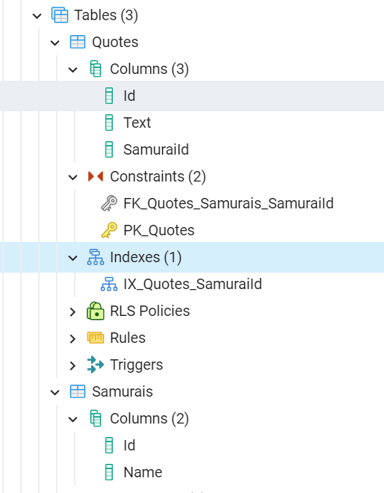
1: * Constraints - 1

Slide 50
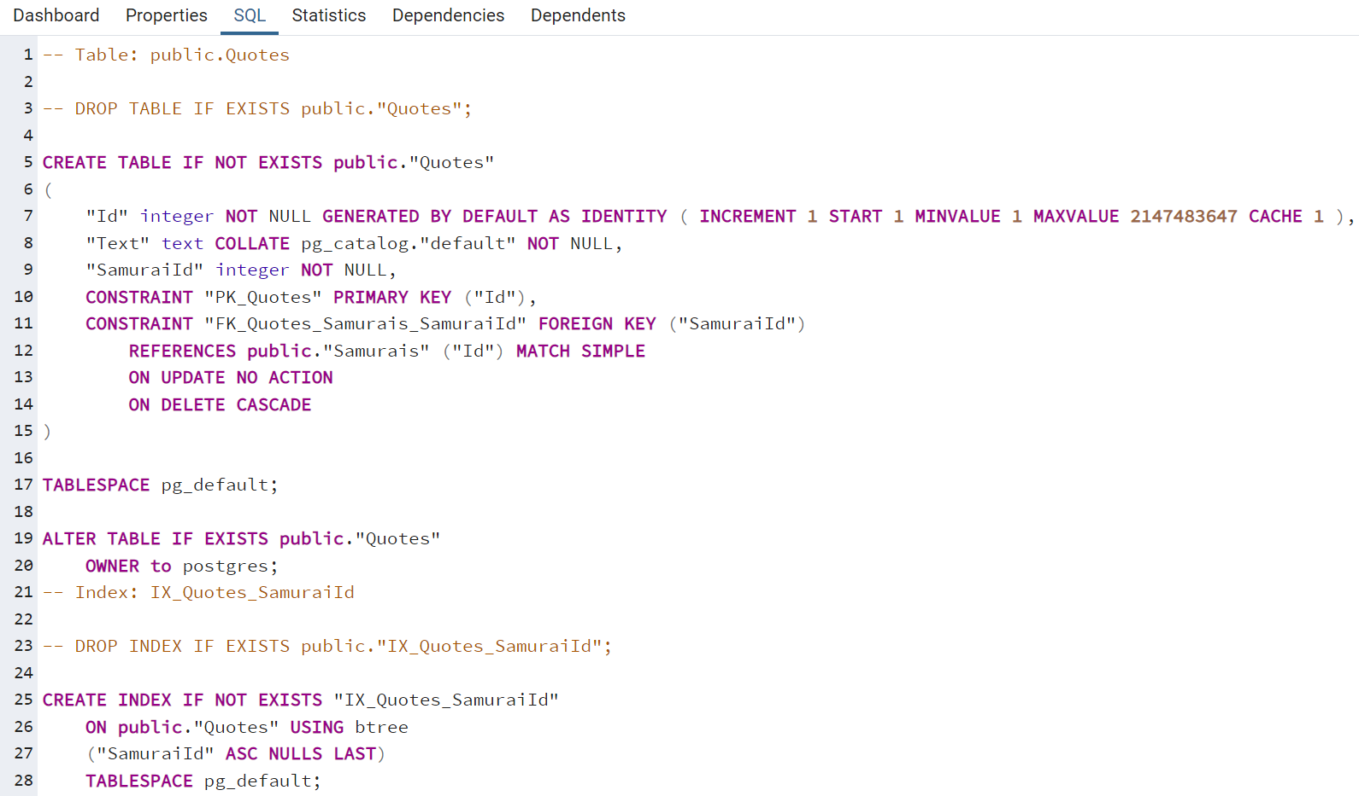
1: * Constraints - 2

Slide 51
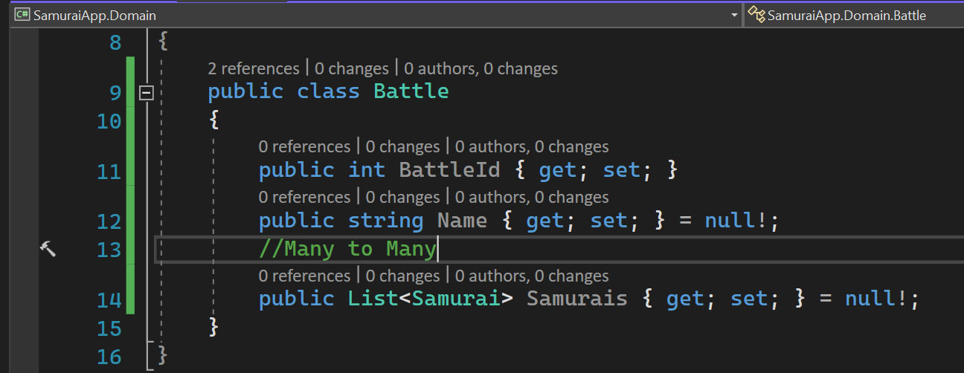
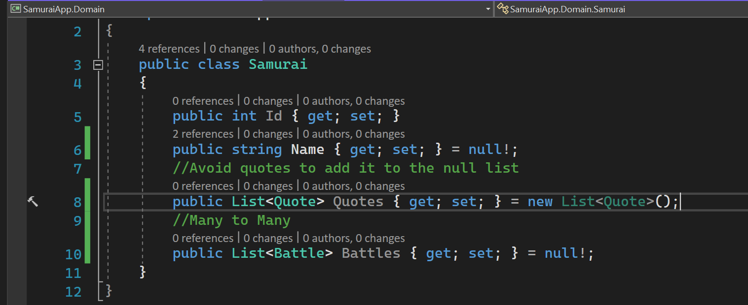
Many to many with skip navigations - 1

Slide 52
Many to many with skip navigations - 2
Under the covers, database will have join table called BattelSamurai.

Slide 53
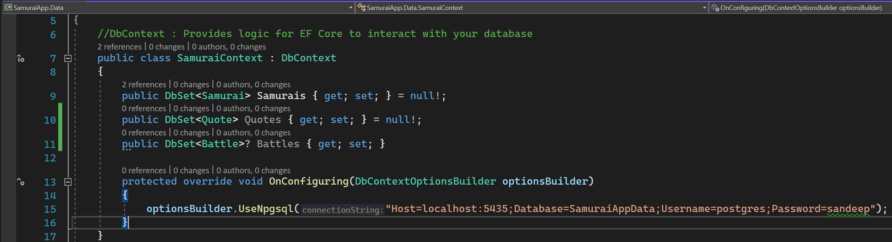
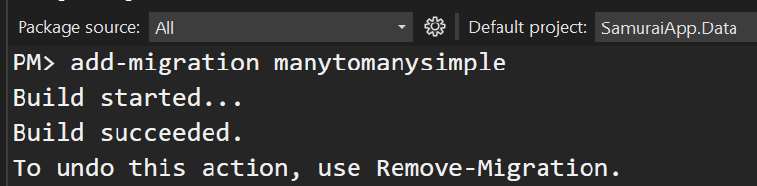
Add Battle context

Slide 54

Many to many with skip navigations - Constraints

Slide 55
EF CORE – MANY TO MANY RELATIONSHIPS – More details
https://www.codemag.com/Article/2010042/EF-Core-5-Building-on-the-Foundation

Slide 56

PAYLOAD
Need to configure the dbcontext to understand this mapping.

Slide 57

Configure many to many with payload
Express *:* using HasMany/With Many
End #1 HAS MANY END #2s vis the list navigation property.
That other end also is WITH MANY of End1, represented by the E1 list property.
Start with either end. There is no difference,

Slide 58

Add migration - 1

Slide 59

Add migration - 2
modelBuilder.Entity<BattleSamurai>()
.Property(bs => bs.SamuraiId).HasColumnName(“SamuraisId”);

Slide 60

Add migration - 3

Slide 61

Add migration - 4

Slide 62
Fluent – Override with totablemapping
modelBuilder
.Entity<BattleParticipant>()
.ToTable(“BattleSamurai”);

Slide 63


Get-migration
The equivalent command is dotnet “ef migrations list”.

Slide 64

CONSTRAINTS

Slide 65

One to one relationship - 1

Slide 66

One to one relationship - 2
Dependent end of 1 to 1 is always optional
Dependent child should always have parent.

Slide 67

Add-migration

Slide 68

Update database

Slide 69

EF CORE POWER TOOLS
Prerequisite – DGML Editor.
EF Core Power Tools relies on Microsoft.EntityFrameworkCore.Design

Slide 70

Install EF CORE POWER TOOLS - 1

Slide 71

Install EF CORE POWER TOOLS - 2

Slide 72

Generate DGML

Slide 73

DGML DIAGRAM

Slide 74
Interacting with ef core data

Slide 75

SQL generated by EF CORE - 1

Slide 76

SQL generated by EF CORE - 2

Slide 77


Logging

Slide 78

Enhance logging

Slide 79

observation

Slide 80


Log LEVEL

Slide 81

Enable sensitive data logging to see parameter values

Slide 82

Bulk operations
At least four operations needed for SQL Server to batch commands.
EF Core uses merge join.

Slide 83

Bulk operations - observation
No merge join is happening in NPGSQL.

Slide 84

Batching can combine type and operations

Slide 85

observation
No merge join is happening in NPGSQL.

Slide 86


BATCH
No batch operations happening in NPGSQL.

Slide 87
Query
_context.Samurais.ToList → EF Core reads model works with provider to work out with SQL.
Queries are cached to reduce repeating the same effort in the same application instance.

Slide 88

Filtering in queries

Slide 89
Filtering in queries - 1

Slide 90

Filtering in queries – 2 – Parameterized query

Slide 91

Filtering in queries – 2 – Parameterized query

Slide 92

Filtering in queries – 3 – LIKE QUERIES IN SQL
Partial Text LINQ : Like /Contains.
One more variant _context.Samurais.Where(s => s.Name.Contains(“J”);

Slide 93

Query AGGREGATES - 1

Slide 94

Query AGGREGATES - 2

Slide 95

Query AGGREGATES - 3
If the query executes two times, then DbCommand will be executed two times.

Slide 96

Query AGGREGATES - 4
DbSet methods are efficient than LINQ methods.

Slide 97

Update simple objects - 1

Slide 98

Update simple objects - 2
Skip & Take combo are great for paging data.
First 10 : Skip(0).Take(10)
Next 10 : Skip(10).Take(10)

Slide 99

Delete simple objects

Slide 100
Connected data access vs DISCONNECTED DATA ACCESS
Connected Data Access : Client storing data locally.
Client and database are on the same network, and they are connected.
Disconnected Clients : UI is disconnected from backend logic with data managed.
For example : A website that interacts with WebAPI. The WebAPI cannot share the DBContext across all its web users. So,
each user will have its own DBContext and gets disposed when it is finished.
DBContext on server can’t track what is happening in the a user’s web browser.
There is no point in keeping DBContext in scope. This gives opportunity to improve query performance since the context
does not require to waste its time on building those tracking objects.

Slide 101

Add new dates - 1

Slide 102


Add new dates - 2

Slide 103

AfteR migration

Slide 104

No tracking - 1
All queries on SamuraiContextNoTrack will default to no tracking.
Use DbSet.AsTracking() for special queries to be tracked.
One more variation :
_context.Samurais.AsNoTracking().FirstOrDefault()
As no tracking returns a query, not a dbset.

Slide 105

No tracking - 2

Slide 106

Mixed tracking

Slide 107
Interacting with related data

Slide 108

Insert related data - 1

Slide 109

Insert related data - 2

Slide 110


Insert related data - 3

Slide 111

Insert related data - 4
Select, Insert, Update – Three Dbcommands executed. Need for performance.

Slide 112

Insert related data - 5
Compared to previous slide. Attach removes extra update.

Slide 113

Insert related data - 6

Slide 114
loading related data
Eager loading : Retrieve data and related data in the same call.
EF Core 5 now have related data in the included method.
Query Projections : Define the shape of query results.
Explicit loading : Already have some data in memory and need to fetch related data by going to database.
Lazy loading : On-the-fly retrieval of data.

Slide 115

Eager loading related data - 1
Default query is with left joins.

Slide 116

Eager loading related data - 2

Slide 117
Eager loading related data - 3

Slide 118

Eager loading related data - 4
Does not work in NPGSQL

Slide 119

Eager loading related data - 5
Does not work in NPGSQL

Slide 120

Eager loading related data - 6
Does not work in NPGSQL

Slide 121

Project related data - 1

Slide 122


Project related data – 2 – use defined types

Slide 123
Project related data – 2 – use defined types

Slide 124

Project related data – 3

Slide 125

Project related data – 4
Anonymous types are not tracked.
Entities that are properties of anonymous type are tracked.

Slide 126

Project related data – 5
Filter the related data that is returned in project type.
Projecting fill entity objects while filtering the related objects that are also returned.
NPGSQL : The debugger does not a show a circular reference between related objects.

Slide 127

Project related data – 6

Slide 128

Explicit LOADING
You can only load from a single object. Profile to determine if LINQ query would be a better performance.

Slide 129

Explicit loading query

Slide 130
Lazy loading
Off by default.
Accidentally, we will abuse it and create performance-oriented problems.
Happens implicitly by mention of the navigation.
Enable with these requirements :
Every navigation property in every entity must be marked virtual.
Microsoft.EntityFramework.Proxies
OnConfiguring optionsBuilder.UseLazyLoadingProxies()

Slide 131

Filtering related data

Slide 132

Modifying data when tracked

Slide 133

Modifying data when not tracked
There are already two entries in the database. So multiple updates happened.

Slide 134

Modifying data when not tracked
Better approach : Entry

Slide 135


Remove payload

Slide 136

Remove payload - 2

Slide 137

Add MANY TO MANY - 1

Slide 138

Add MANY TO MANY - 2

Slide 139

Run migrations

Slide 140

Working with many to many relationships - 1

Slide 141

Working with many to many relationships - 2

Slide 142

Working with many to many relationships - 3

Slide 143

Working with many to many relationships - 4

Slide 144

Working with many to many relationships - 5
Solution to hardcoding.

Slide 145

Altering or removing many to many joins - 1
Deleting a M2M relationship is easier with
Stored procedure
Many to Many mapping

Slide 146

Altering or removing many to many joins - 2

Slide 147



Adding a many to many payload

Slide 148

One to one -1

Slide 149

One to one -2

Slide 150
ASP.Net Core 6 + EF 6

Slide 151

AS.Net Core web api

Slide 152

WEB API

Slide 153

WEB API

Slide 154

USE JSON FORMATTER (Chrome EXTENSION)

Slide 155

Add domain

Slide 156

API Controller with actions using entity framework

Slide 157


Slide 158

Npgsql entity framework core

Slide 159

Query tracking behavior

Slide 160

App settings

Slide 161

Add context with no tracking

Slide 162

EF CORE CONTEXT CONSTRUCTOR

Slide 163

Remove onconfiguration

Slide 164

API SAMURAIS

Slide 165

LOGS

Slide 166

Rest client

Slide 167

GET

Slide 168

POST

Slide 169

OBSERVE PUT

Slide 170

put

Slide 171

DELETE

Slide 172

delete

Slide 173
AUTOMATED TESTING

Slide 174

Connection string

Slide 175
Change connection string

Slide 176

Ms test project

Slide 177

Test project

Slide 178

framework

Slide 179

Add project reference

Slide 180

Database tests

Slide 181

Use in memory

Slide 182

In memory tests – overload constructor

Slide 183

In memory tests

Slide 184

Refactor console app logic - 1
EF core’s raw SQL methods only work with relational database providers.

Slide 185

Refactor console app logic - 2

Slide 186

Business data logic tests

Slide 187
Unit testing using APPILCATION FACTORY

Slide 188
ExTRAS

Slide 189

Temporal tables

Slide 190
dotnet

Slide 191

Dotnet tool

Slide 192


Migration bundle

